Slide 1
Introduction to Sensory Integration and Sensory Processing Disorders
Dawn Hoffman, M.O.T, OTR/L, SIPT Certified

Slide 2
Course Objectives
To understand the basic concept of sensory integration as a theory
To describe typical functioning of our sensory systems
To understand the difference between sensory preferences and sensory processing disorder (SPD)
To understand the terminology used in discussing SPD/SI
To develop a basic understanding of sensory processing disorders and how these disorders impact learning, participation and behavior
To understand the role of sensory integration therapy for children with SPD
To identify sensory strategies that can be support a child with SPD

Slide 3
Sensory Integration is…
a term that applies to neurological functions
a term that also refers to a theory that identifies ways in which early sensory experiences are important in normal development
and a method used by therapists to improve the lives of children and their families who are experiencing difficulties fully participating in natural environments where they live, learn and play.
Reference: Ruzzano, S., Smith Roley, S., & Mailloux, Z. (2003). Applying Sensory Integration Where Children Live, Learn, and Play (DVD). Torrance, CA: Pediatric Therapy Network

Slide 4
Dr. A. Jean Ayres
Credentials: BS and MA degrees in occupational therapy; Ph.D. in educational psychology
The first researcher clinician from the therapy fields to:
Define the impact of sensory processing on learning, emotions and behavior;
Design and standardize assessments that provide a comprehensive understanding of sensory integrative function and dysfunction;
Create a set of intervention principles to address sensory integration deficits for improved function and participation;
Implement a carefully designed research program over time to study and refine knowledge about sensory integration function and dysfunction;
Develop and articulate a theoretical framework that incorporated these concepts, principles and techniques (Ayres, 1972).
Reference: siglobalnetwork.org

Slide 5
Sensory Integration Theory
Sensory integration theory proposes that sensory integration is a neurobiological process that organizes sensation from one’s own body and from the environment and makes it possible to use the body effectively within the environment. (Ayres, 1973)

Slide 6
Sensory Integration
”The organization of sensations for use” –A. Jean Ayres
“Directing the Traffic”
“Nourishing the Brain”
“Making a Whole From Parts”
Reference: Ayres, A. J. (2005). Sensory integration and the child, 25th anniversary edition. Los Angeles, C.A.: Western Psychological Services.
Notes:
Brain locate, orders, directs sensations to not allow traffic jans
Food for the brain- needed for good digestion
SI “puts it all together”- Orange example- everything comes together in one part of the brain to experience as a whole

Slide 7
SI Frame of Reference
The Sensory Integration (SI) frame of reference focuses on how the interaction between the sensory systems including auditory, vestibular, proprioceptive, tactile, and visual systems, provides integrated information that contributes to a child’s learning and adaptive behaviors.
The key consideration is that children have the abilities to make adaptive responses to constantly changing sensory environments.
Notes:
Adaptive response is a “purposeful, goal-directed response to a sensory experience”
In a adaptive response, we master a challenge, and learn something new
Helps the brain to develop and organize itself

Slide 8
SI Frame of Reference
The outcomes of sensory integrative process consist of:
  The ability to modulate, discriminate, and integrate sensory information from the body and from the environment,
  Self-regulation to regulate and maintain his/her arousal level to focus on task,
  Maintenance of postural control, ocular control, bilateral coordination, and laterality,
  Praxis and organizing behavior for tasks and activities, and
  Development of self-esteem and self-efficacy.
Notes:
Praxis: the ability to conceptualize, plan and sequence a new or different activity
“Ideation, planning and execution”

Slide 9
SI Frame of Reference
Interventions using the SI frame of reference include use of therapeutic equipment to provide children with various sensory opportunities, with at least two of these three sensations (tactile, vestibular, and proprioceptive). Sensations are provided in a structured environment, graded to a greater or lesser intensity depending on the needs of each child.
Reference: https://ottheory.com/therapy-model/sensory-integration-frame-reference

Slide 10
Definition of Sensory Processing
”Sensory processing is a term that refers to the way the nervous system receives sensory messages and turns them into responses."
Reference: Miller, L. J. (2014). Sensational Kids. New York: Perigree

Slide 11
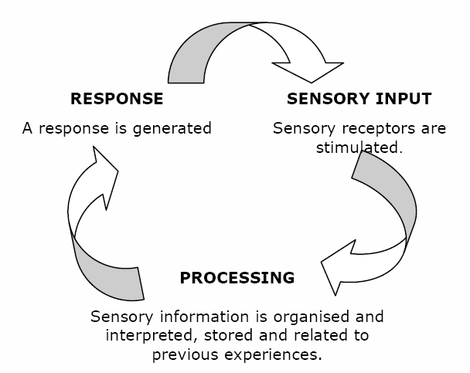

Slide 12
Effective Sensory Processing Promotes:
Self-Regulation/Level of Alertness
Development of Motor Skills
Communication
Social Participation
Purposeful Interaction with the Environment
Cognitive Development

Slide 13

Sensory Systems: The Basic 5
Seeing (visual system)
Hearing (auditory system)
Tasting (gustatory system)
Smelling (olfactory system)
Touching (tactile system)

Slide 14
Our “Hidden Senses”
Proprioception (sense of body position and movement)
Vestibular (sense of movement in space)

Slide 15
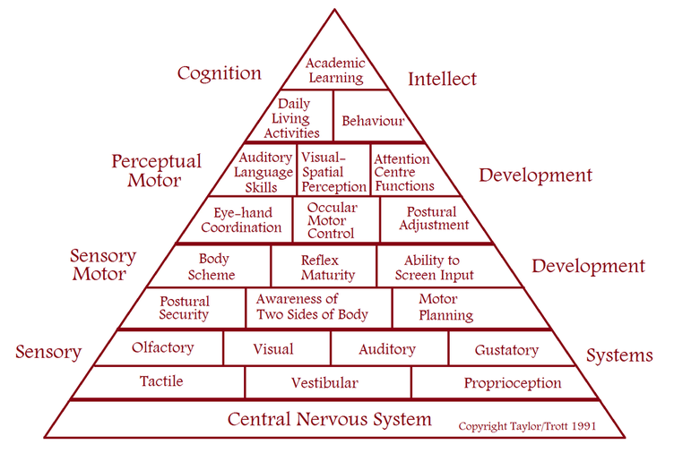
Sensory Systems: Building a Strong Foundation

Slide 16
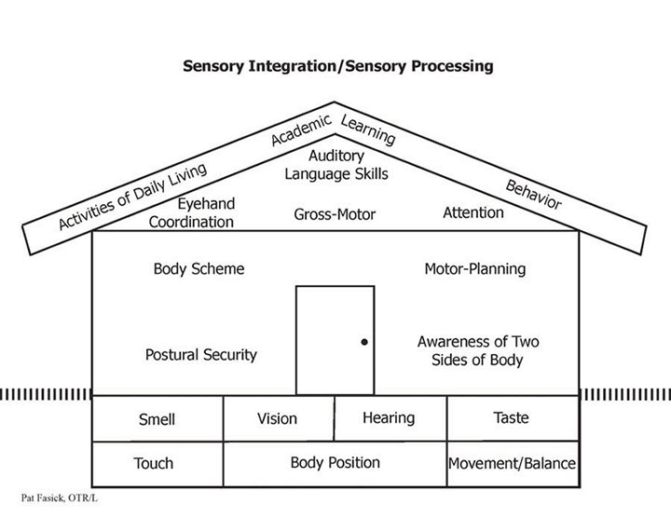

Slide 17
Visual Sense
Vision is the process of gathering, analyzing, storing, and responding to light information.
  Vision includes visual acuity (seeing), coordination of the two eyes, focusing, eye movement control, and visual perceptual skills.
  When we use our eyes, we are developing visual maps, which we use with our body maps to figure out how to move around successfully.

Slide 18
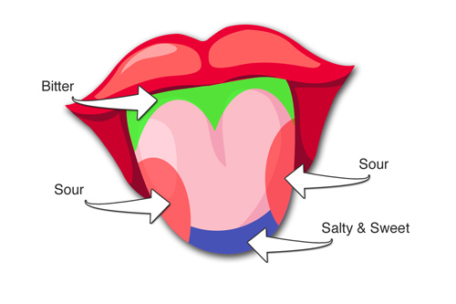
Taste Sense (Gustatory)
Taste is the sensation produced when a substance in the mouth reacts chemically with receptors of taste buds.
2000 and 5000 taste buds are located on the back and front of the tongue.
5 basic tastes: sweet, sour, bitter, salty, umami.
  In general the gustatory system does not work alone. While eating, our somatosensory system is giving us information about consistency, texture and temperature of the food. The olfactory system is also needed to distinguish the flavor.

Slide 19
Sound Sense (Auditory)
“The human sense of hearing is attributed to the auditory system, which uses the ear to collect, amplify, and transduce sound waves into electrical impulses that allow the brain to perceive and localize sounds.” (Boundless, 2015)
We collect sound memories that allow us to distinguish what an object is or who a person is by sound alone.
Sound travels across distances and we learn to associate sound with distance.

Slide 20
Smell Sense (Olfactory)
Your sense of smell processes odors and can distinguish between thousands of scents.
Olfactory information travels not only to the limbic system (which governs emotions, behaviors, and memory storage) but also to the brain's cortex, where conscious thought occurs.
It combines with taste information in the brain to create the sensation of flavor.

Slide 21
Touch Sense (Tactile)
Tactile refers to our sense of touch and to the information our body gets through the skin.
  Some of the tactile receptors are close to the surface of the skin and others are deep in the skin.
  Gives us information about pain, temperature, pressure.
“Provides information primarily through the surface of our skin, from head to toe, about the texture, shape and size of objects in the environment. It tells us whether we are actively touching something or are passively being touched. It helps distinguish between threatening and non-threatening touch sensations.” (Kranowitz, 2003)
Deep pressure releases dopamine (washes away cortisol, stress). (Harper, 2011)

Slide 22
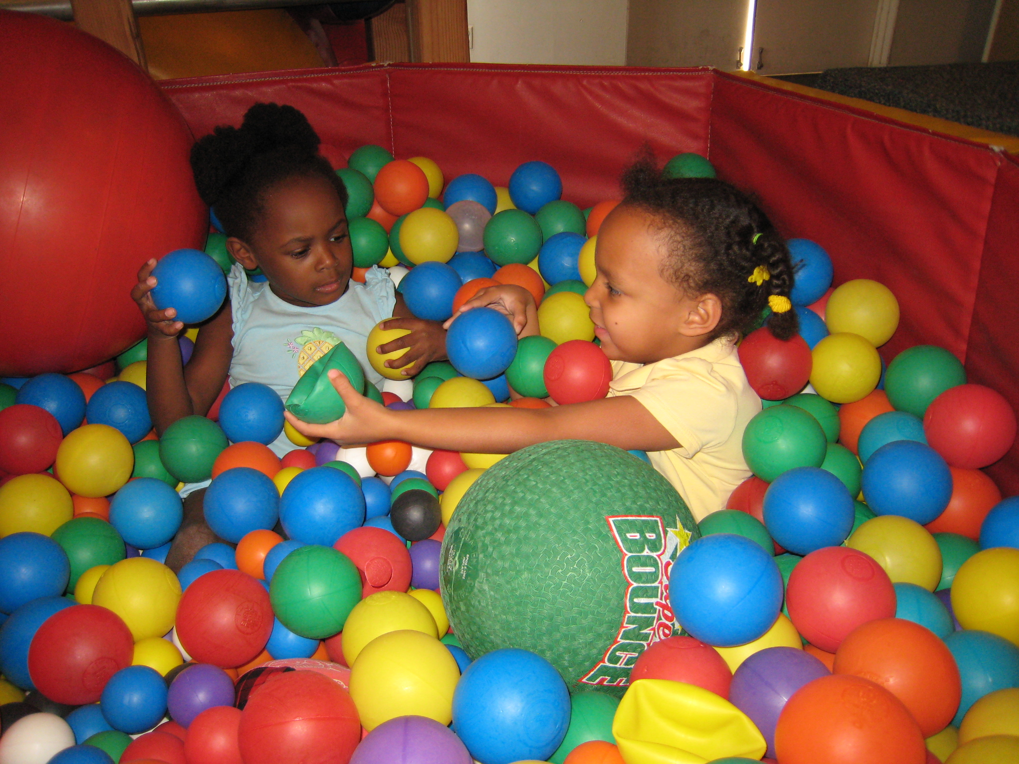

Slide 23
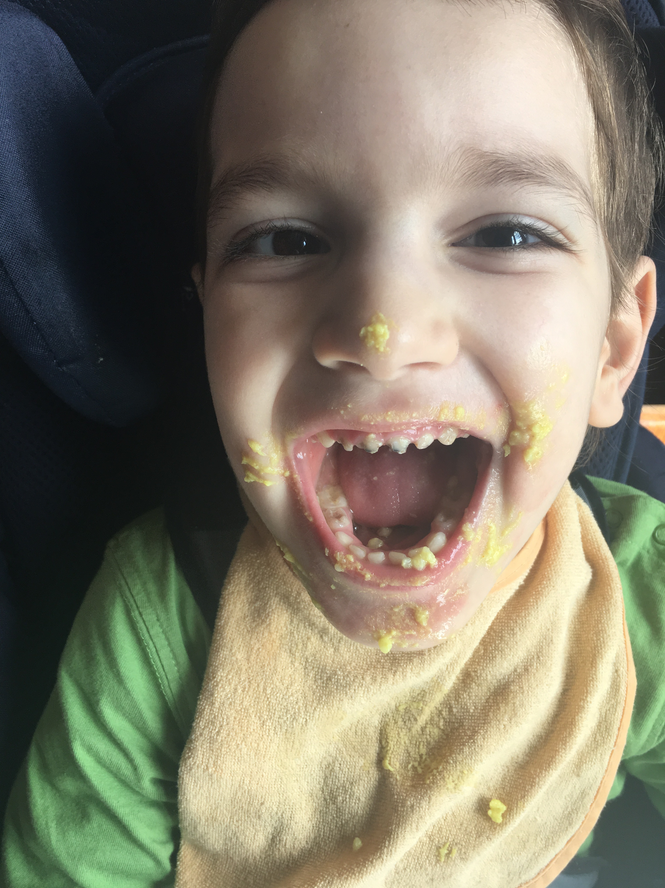

Slide 24

Movement Sense (Vestibular)
It is the first sensory system to fully develop in utero.
The vestibular system receives input from receptors located in the inner ear regarding the position and movement of the head in relation to gravity.
This sense allows us to maintain our balance and gives us the confidence that we can maintain a position without falling.
Coordinates eye and head movements.
Helps develop and maintain normal muscle tone.
Helps coordinate both sides of the body together.

Slide 25
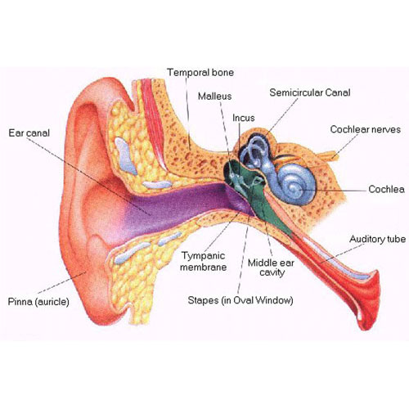
Vestibular System

Slide 26
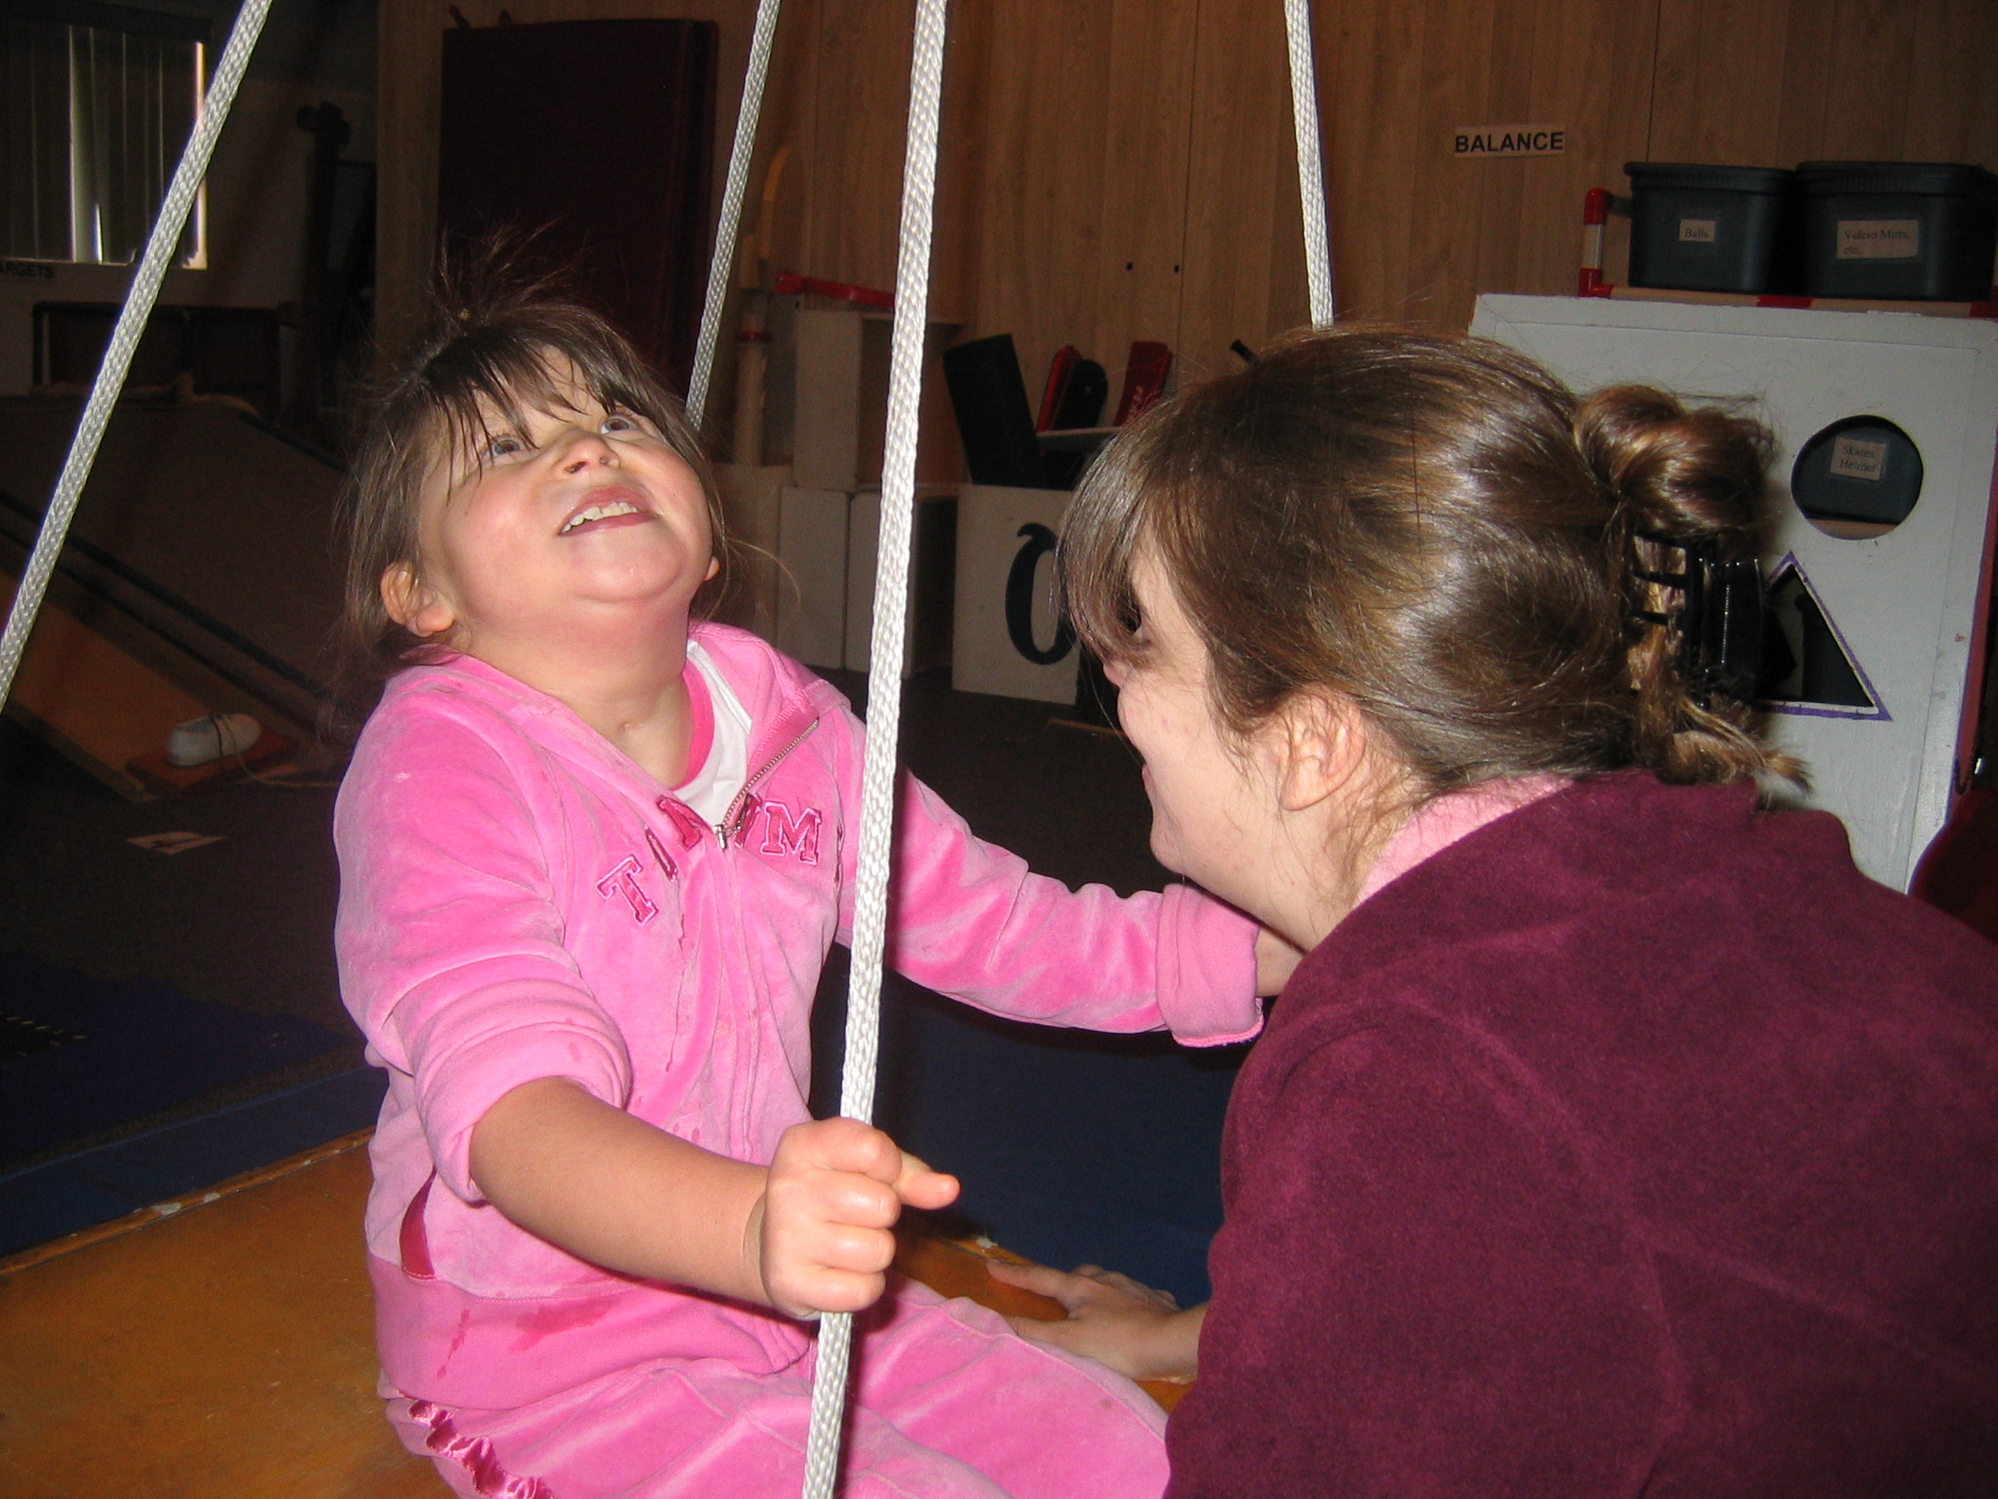

Slide 27
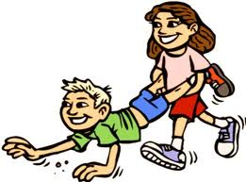
Position Sense (Proprioception)
The sense that tells us where are body parts are and what they are doing.
Receptor sites are in our joints, muscles, tendons and ligaments.
Our “unconscious movement”.
Information allows us to know where our body is when we close our eyes.
This sense underlies one’s ability to place body parts in a position in space and to grade movements (i.e. the ability to judge direction of force and pressure). (Whitney, 2004)

Slide 28
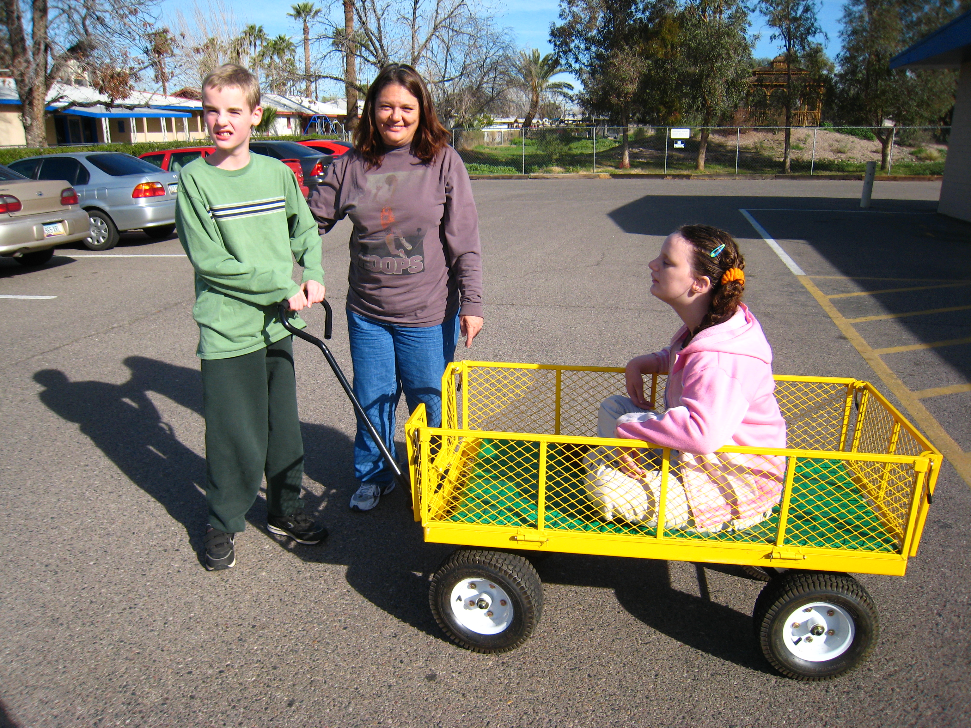

Slide 29
Sensory Processing Disorder
Sensory processing disorder is simply what happens when the sensory information from the environment and from within our own bodies does NOT get organized and interpreted correctly and efficiently by the brain. (sensoryprocessingmadesimple.com)
Only considered a disorder when it significantly impacts daily routines and tasks.

Slide 30
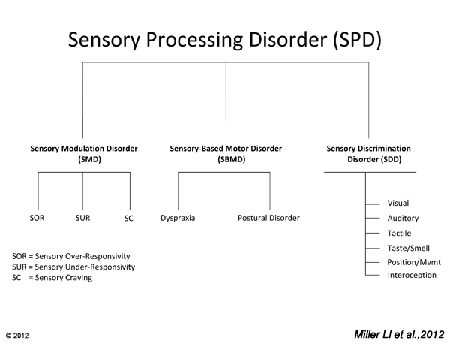
Notes:
Classification of Sensory Processing Disorder: Patterns and Subtypes, Lucy Jane Miller

Slide 31
Sensory Modulation Disorder
Difficulty taking in sensory information from the environment and making appropriate behavioral responses.
Responses don’t match the nature or intensity of the sensory information.
Three sub-types:
Sensory Over-Responsivity
Sensory Under-Responsivity
Sensory Seeking/Craving

Slide 32
Sensory Over-Responsivity
Sometimes called “Sensory Defensiveness” or “Sensory Sensitivity”.
Responds to sensory input more intensely, more quickly or too long.
May occur in only one of the senses, or in a combination of 2-3.
Behaviors associated with sensory sensitivity include difficulties with transitions/changes, impulsivity, excessively cautious/refusal to participate in new activities, irritability/tantrums/meltdowns, aggression, or the child may become severely withdrawn.
These individuals have a tendency to notice each stimulus as it presents itself.
However, some advantages of sensory sensitivity include a high level of awareness of the environment and an ability to discriminate or attend to detail.

Slide 33
Sensory Under-Responsitivity
Also called “Low Registration”.
Exhibit less of a response to the sensory information, take longer to react, and/or require intense or long lasting sensory input to respond to things in their environment.
Behaviors can include being socially withdrawn/quiet, preferring solitary games, often labeled “lazy” or “slow” and can appear unmotivated, seems unaware of surroundings/sensory input, high pain threshold.
However, these individuals find it easier to focus on tasks of interest in distracting environments.
They tend to be more flexible and comfortable in a wide range of sensory environments.

Slide 34
Sensory Seeking/Craving
Insatiable craving for sensory experiences.
Need increased intensity and duration of sensory input.
Actively explores the environment and seeks out sensory input, often in ways that are not socially acceptable or safe.
Behaviors associated with sensory seekers include difficulty sitting still/constantly “on the go” (spinning, jumping, swinging, rocking), may fixate on objects visually, may prefer foods with strong flavors, may become aggressive or angry when required to stop what he is doing, takes excessive risks, difficult to calm, may be excessively affectionate.
Tend to become easily bored and have difficulty functioning in low-stimulus environments.

Slide 35
Sensory Discrimination Disorder
Difficulty with interpreting and distinguishing messages within one or more sensory system.
Often require extra time to process sensory information.

Slide 36
Sensory-Based Motor Disorder
Describes the problems that occur when motor responses to sensory input don’t “match up”.
Often attributed to problems in our “hidden senses”.
2 Subtypes:
1. Dyspraxia
2. Postural Disorder

Slide 37
Dyspraxia
Difficulty with organizing movement
Motor planning challenges
“The brain of a person with dyspraxia does not process information in a way that allows her to plan what to do, how to do it, and/or how to correct mistakes when they happen” (Sensational Kids, pgs 229-230)
Difficulty PLANNING movements
Emotional impact of dyspraxia

Slide 38
Postural Disorder
Problems with body stability and mobility
Poor core stability (proximal stability)
Difficulty DOING activities
Often occurs with other sensory processing challenges (under-responsivity, dyspraxia, sensory discrimination disorder)

Slide 39
Evaluating Sensory Integration
Sensory Integration and Praxis Test (SIPT)
Sensory Processing Measure
Sensory Profile
Clinical Observations

Slide 40
SIPT
The SIPT is ‘gold standard’ diagnostic tool used in the assessment and diagnosis of Sensory Processing and/or Dyspraxia.
Age Range: 4 years to 8 years, 11 months
17 subtests which fall into four categories:
(1) motor-free visual perception,
(2) somatosensory,
(3) praxis,
(4) sensorimotor
Therapist must hold specific post graduate qualifications in order to administer and interpret this assessment.

Slide 41
Sensory Processing Measure
Provides a complete picture of children's sensory processing difficulties at school and at home.
Ages: 5-12 years
Norm-referenced standard scores for two higher-level integrative functions: praxis and social participation, and five sensory systems – visual, auditory, tactile, proprioceptive, and vestibular.
***SPM-P for 2-5 year olds

Slide 42
Sensory Profile 2™
Standardized questionnaire completed by caregiver and/or teacher
Used to evaluate children's sensory processing patterns at home, school, and in the community
Birth to 14 years 11 months
Dunn’s Framework of Sensory Processing: Sensory Sensitivity, Sensation Avoiding. Low Registration, Sensory Seeking
https://www.ilota.org/assets/documents/Conference/2014Presentations/s15%20assessing%20sensory%20strengths%20and%20challenges.pdf

Slide 43
Observations
Play
Organization of Behavior
Sensory Observations
Postural Control/Muscle Tone
Bilateral Coordination, Crossing Body Midline
Motor Planning (Praxis)
Notes:
Takes approximately 400 repetitions to create a new synapse in the brain- unless it is done with play- then 10-20!- Dr Karyn Purvis

Slide 44
Observations Based on SI Theory
Forearm Alternating Movements
Sequential Finger Touching
Finger-to-Nose Test
Eye Movements
Supine Flexion
Prone Extension
Protective Extension

Slide 45
Observations Based on SI Theory
Weight Bearing and Proximal Joint Stability
Gravitational Insecurity
Projected Action Sequences
Bilateral Motor Coordination
Reactions to Sensations
Free Play
Praxis
Blanche, E.I. (2002). Observations Based on Sensory Integration Theory.

Slide 46
Key Points to Remember
“A child’s occupation is play”. Children learn through play. Activities must be fun!
Focus on the child. When working with the child, clear your mind of all distractions, look at the child and say to yourself “for this period of time, I am yours”.
Spend time learning to be a good “detective”. Observe the child to find out what is motivating to him and how he responds to various stimuli/activities.
Begin with activities that the child will be successful in completing. Slowly increase the challenges.
Consult a trained occupational therapist for consultation and to determine if a comprehensive evaluation is needed.

Slide 47
SMART play
Lucy Jane Miller’s work at the STAR Center
It’s not just play, it’s SMART play!
S: Sensory
M: Motor
A: Attuned
R: Relationship-rich
T: Time

Slide 48
Principles of Sensory Integration Therapy (SIT)
Therapy is accomplished through play activities
Therapy must include a wide range of sensory opportunities- focus on adaptive responses
Active participation is essential
Activities should be child-directed
Activities need to have a “Just Right Challenge”

Slide 49
Strategies for Sensory Sensitivity
  General Recommendations:
  Consider using a visual schedule to help prepare the child for transitions, as well as to understand there is a beginning and an end to the activities.
  Write sensory stories (similar to social stories) about the sensory sensitivity, helping the child learn effective coping strategies,
  Incorporate breaks in the child’s day, allowing for place where the child can retreat.
  Respect the child’s right to refuse. Never force a child with sensory sensitivities to engage in activities he finds aversive.

Slide 50
Strategies for Sensory Sensitivity
Auditory: School: Consider where the child sits in the classroom, try to place him near students who are quiet, or in a quiet area. Prepare the child ahead of time for noises, such as fire drills. Allow the child to wear headphones during individual work. Clinic: Minimize noise in the environment, use quiet voices when possible, limit unnecessary chatter. Home: Prepare the child ahead of time for noises he may find aversive, such as blenders, vacuums. If needed, allow him to use ear plugs or headphones when these appliances are being used. Consider trying headphones when going out into noisy places, such as stores.
Visual: School/Clinic: Consider the lighting in room. Can it be dimmed? Can you drape cloth over the lights? Use dividers around the child’s desk or work station. Allow the child to wear sunglasses, a hat or visor inside the room. Minimize clutter. Home: Allow the child to wear sunglasses, even inside the home. Use soft, muted colors on walls, bedding. Minimize clutter by placing toys/materials in boxes, or away in a closet.

Slide 51
Strategies for Sensory Sensitivity
Olfactory: All environments: Be careful with cleaning products, request teachers/therapists refrain from using perfume, scented lotions, etc.
Gustatory: All environments: Don’t force the child to eat foods. School: Allow the child to eat food provided from home. If the child can tolerate it, offer the child the food provided from the school, but allow him to refuse. Even sitting near others eating foods he finds too be aversive may be too much. Consider seating options at meals. Clinic: Explore food items without eating, such as painting with cut up fruits and vegetables, crumbling cookies or crackers for a craft project. Home: Recommend parents seek help in finding a feeding specialist.

Slide 52
Strategies for Sensory Sensitivity
Tactile: All environments: Limit unnecessary touch. Educate family and friends to show affection to child without hugging (if child can’t accept). Prepare the child for tactile activities by giving him deep pressure squeezes. School/Clinic: Make modifications during art projects, allowing the child to use paintbrushes, toothpicks instead of finger painting. Clinic: Have child explore different textures using a “feely bag”, allow the child to explore “no mess” tactile play, placing substances in zip-lock bags, Try using dry substances, such as large containers filled with rice, beans or pasta. When exploring wet substances, always have wet towels, or a bucket of water, nearby. Home: Consider textures of the child’s clothing, bedding; cut out clothing tags if needed. Offer him opportunities to be near tactile substances, such as watching meals be prepared in the kitchen or when washing dishes.

Slide 53
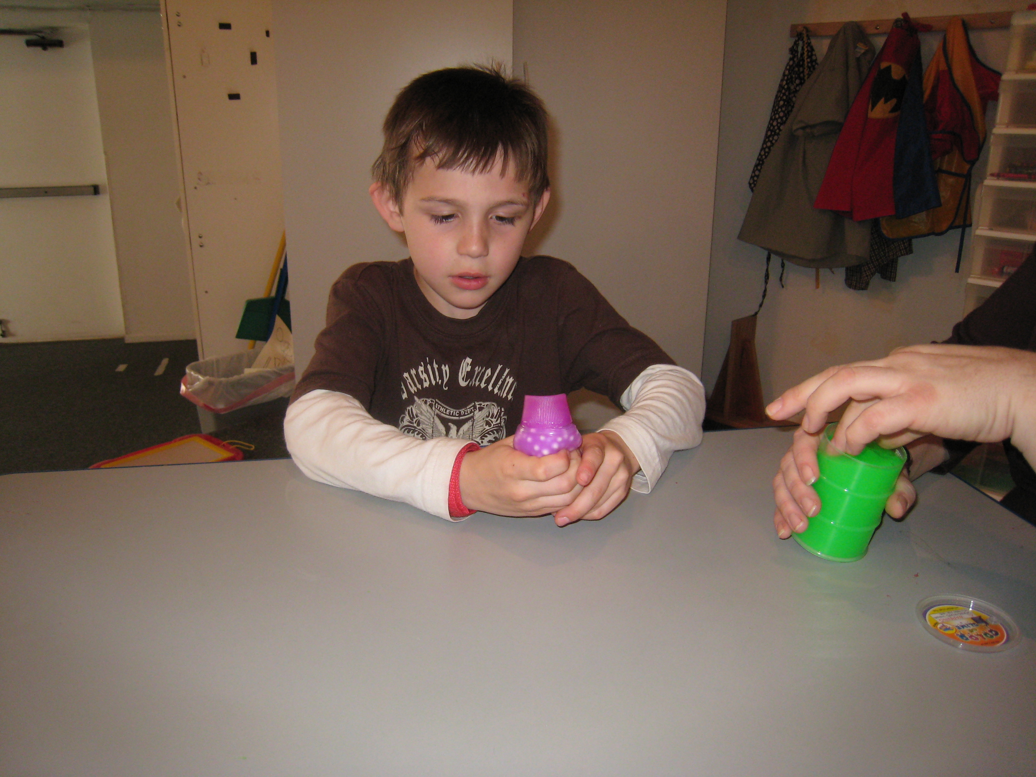

Slide 54
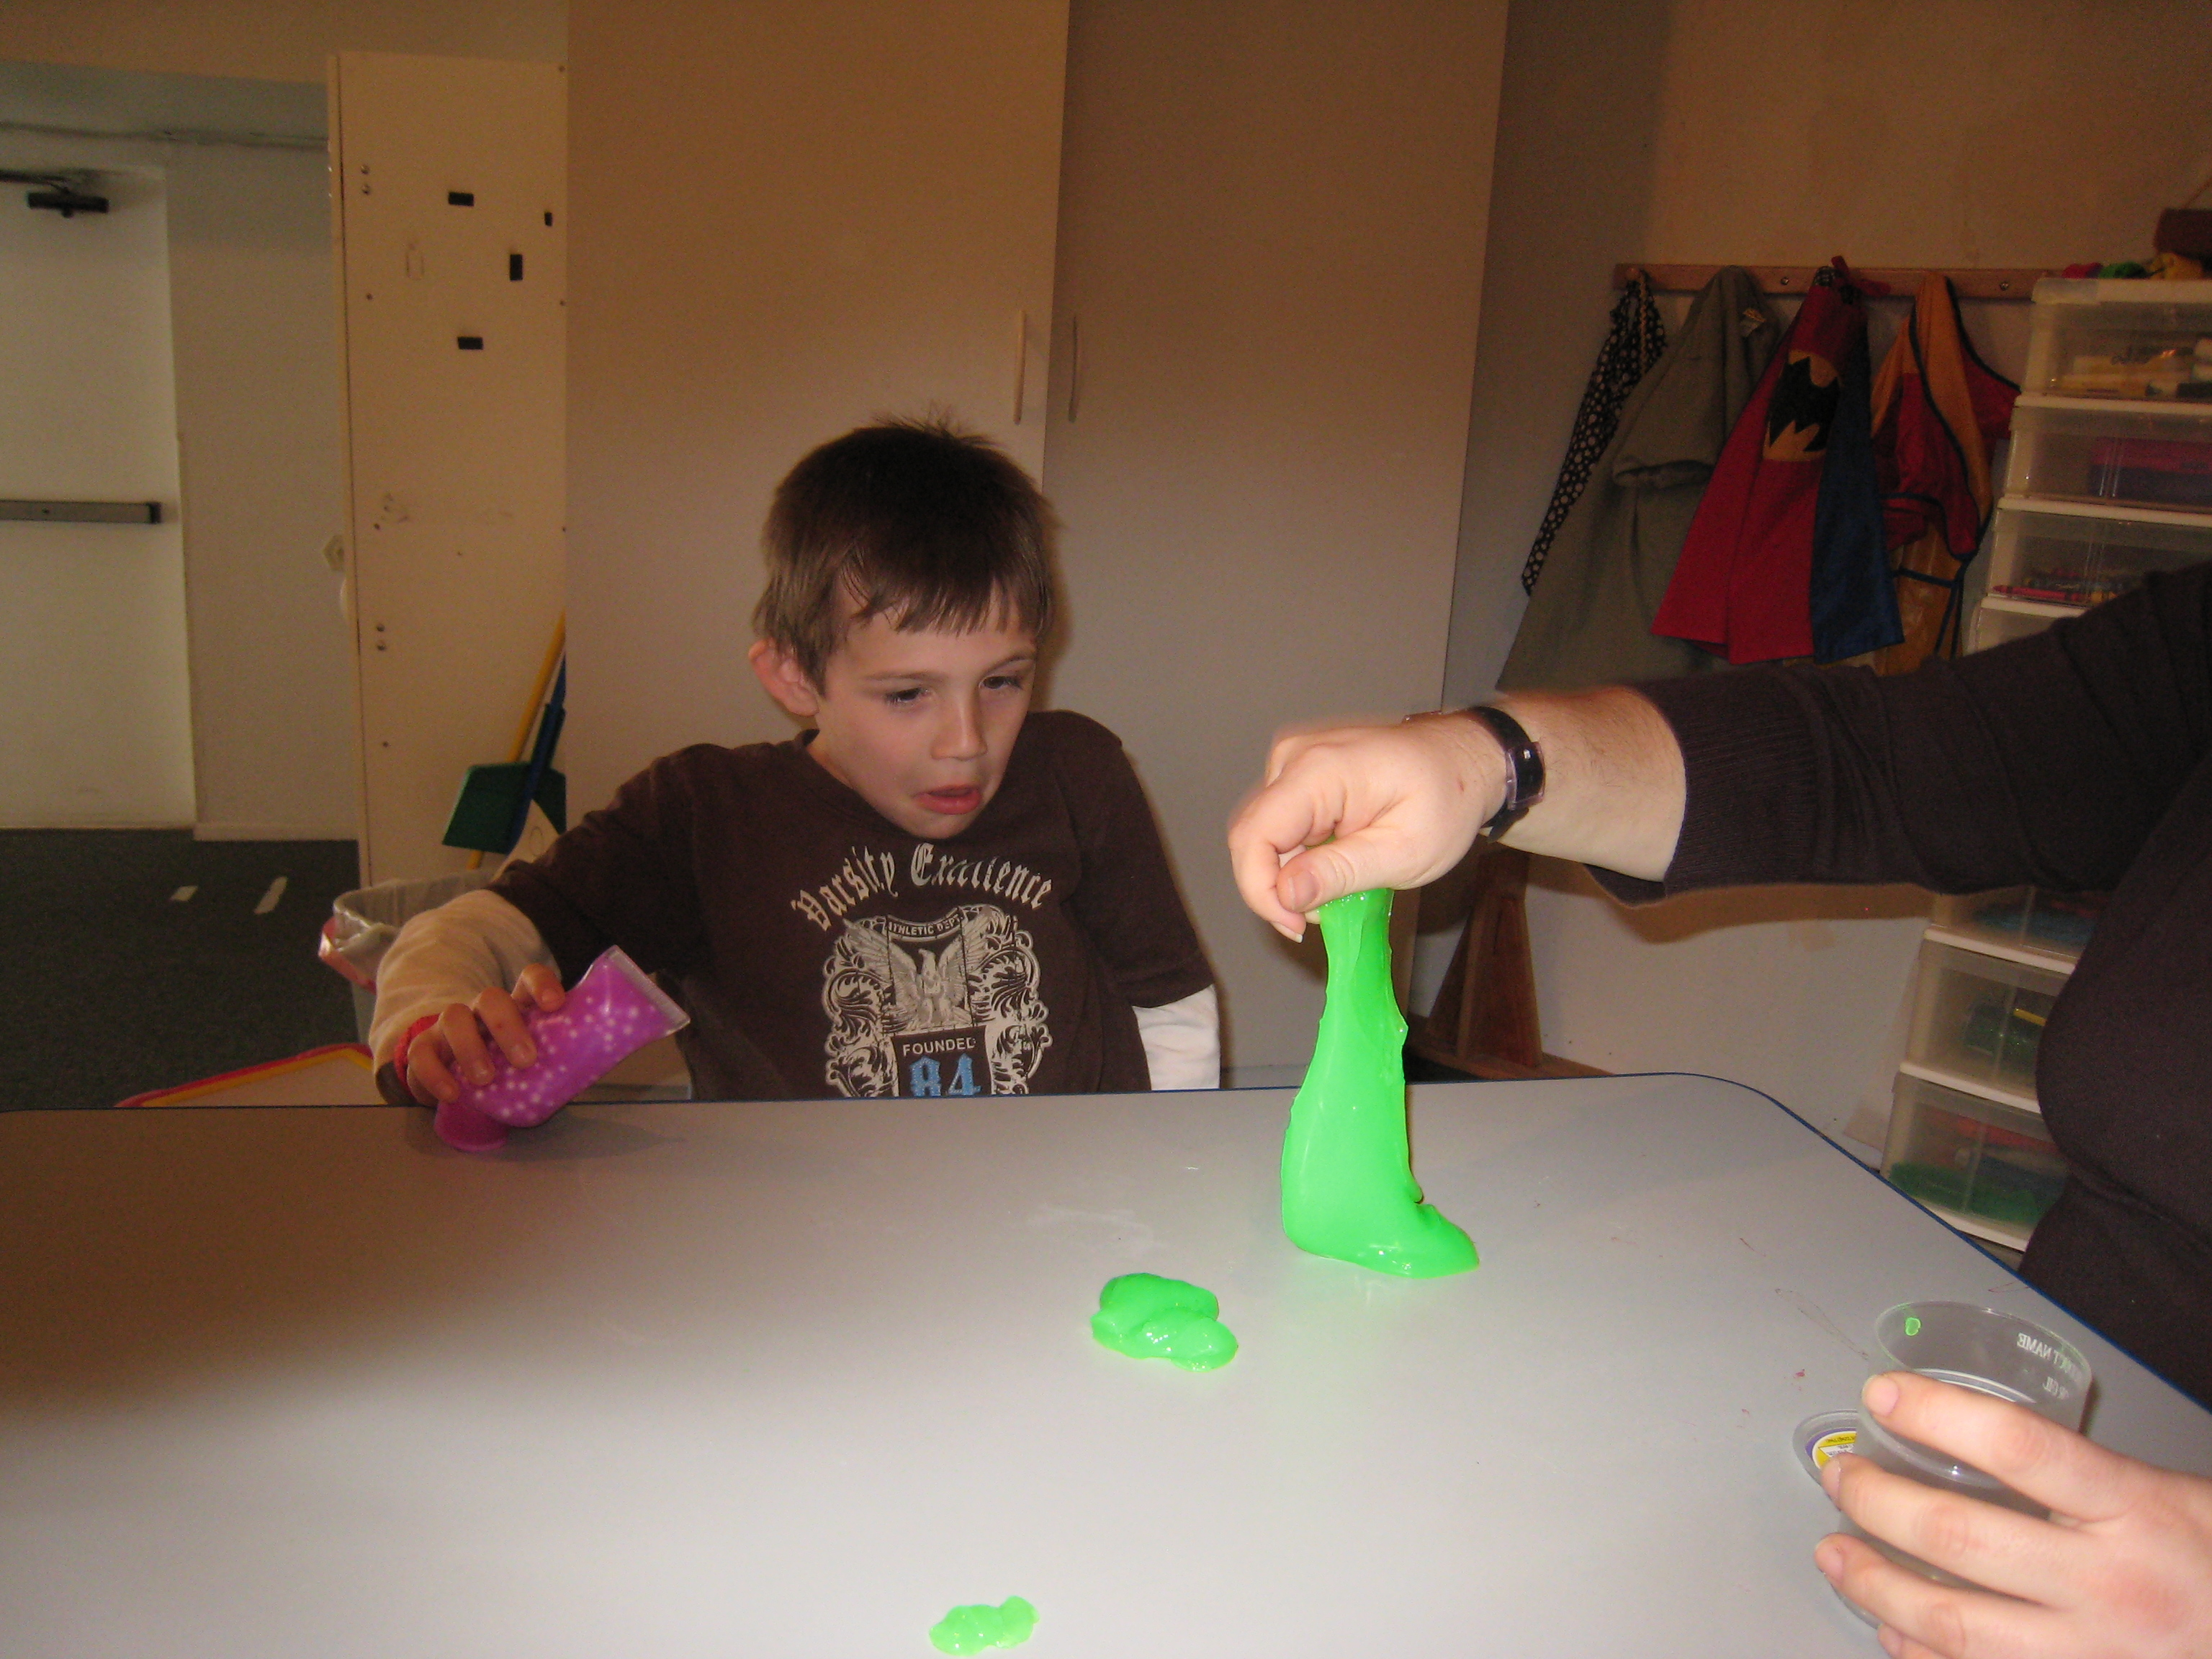

Slide 55
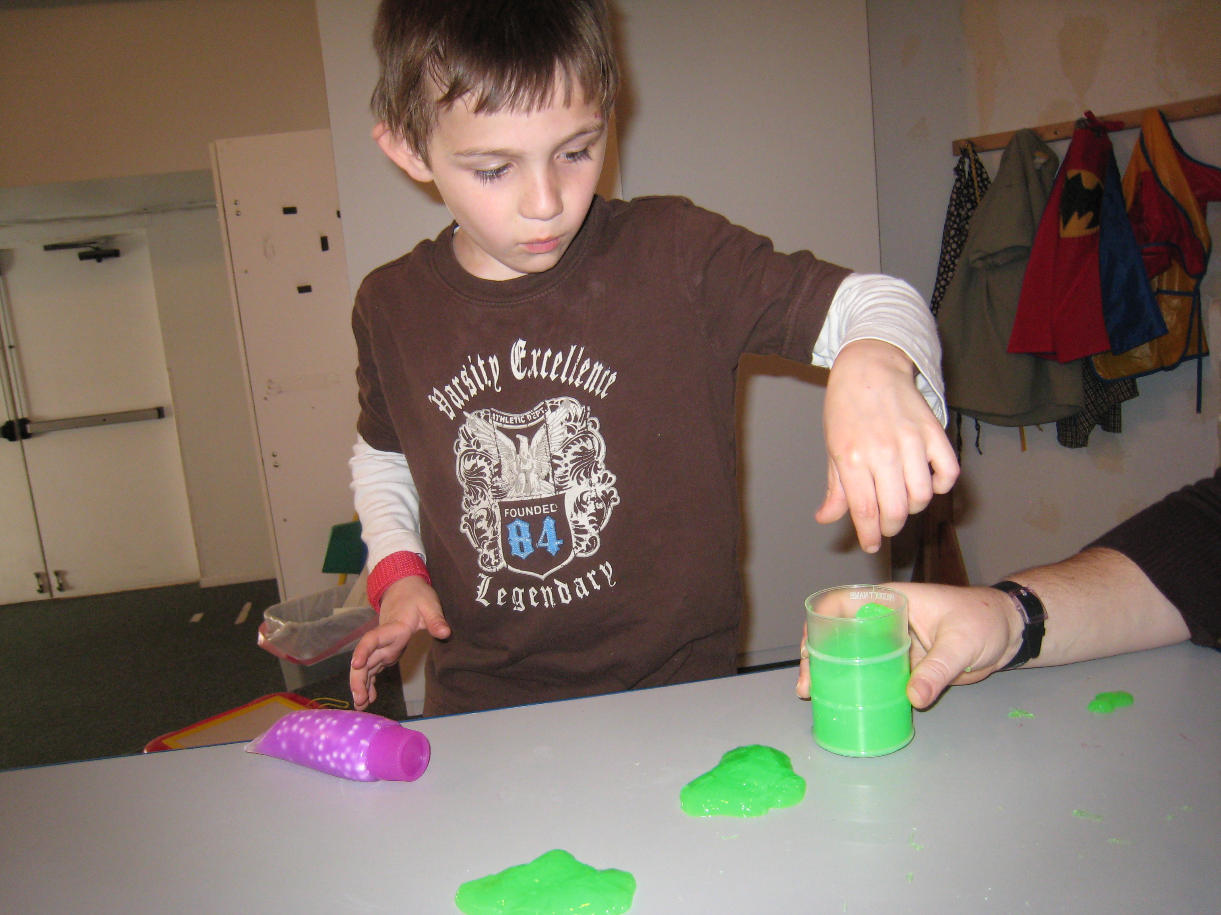

Slide 56
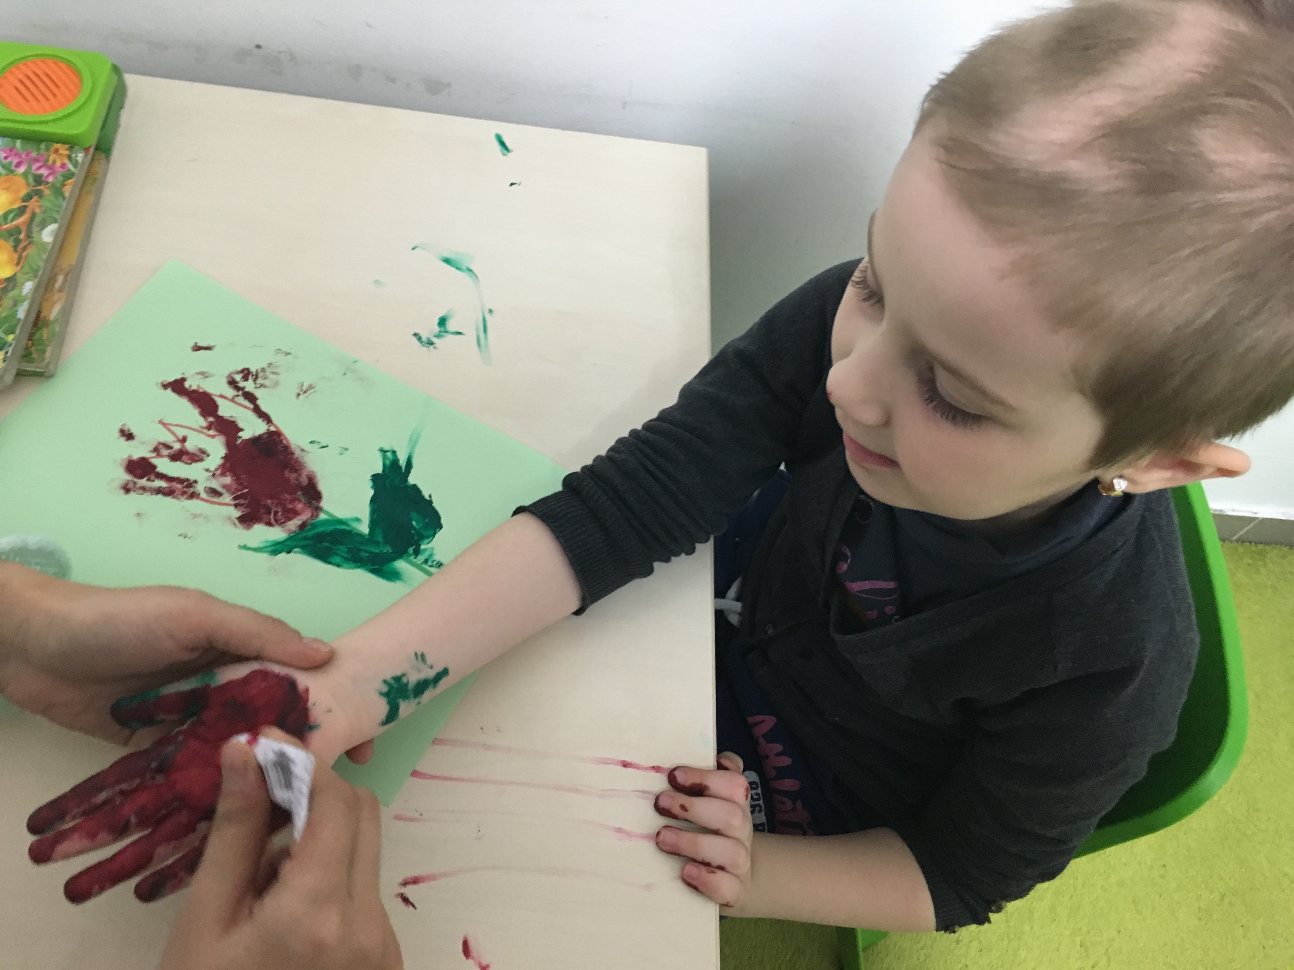

Slide 57
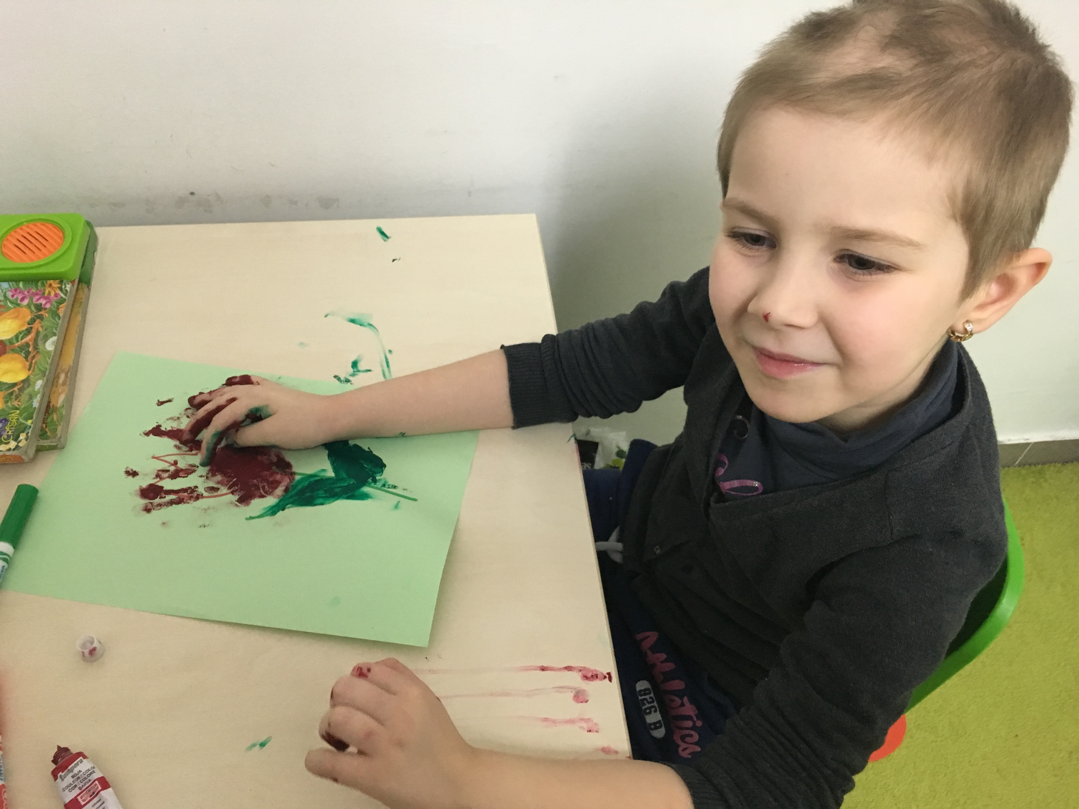

Slide 58
Strategies for Sensory Sensitivity
Vestibular: School: Offer play activities that don’t require movement that the child perceives as fearful. For example, have the child walk around the playground instead of swinging. Clinic: Provide slow, controlled movement, such as linear swinging, slow bouncing on a ball with the child’s feet on the ground. Try pairing proprioceptive input to help calm.
Proprioception: All environments: Proprioceptive input is our greatest organizing sense and can help with calming on over-responsive sensory system. Incorporate heavy work activities throughout the day, but especially before and after engaging in activities where there are known sensitivities. Offer graded weighted activities- things they can squeeze, push/pull, lift/carry.
Vestibular: School: offer play activities that don’t require Provide slow, controlled movement. Examples may include linear, allow feet to be on ground
Proprioception: graded weighted activities- things they can squeeze, push/pull, lift/carry. If prop ok, then use heavy work activities as this give calming/organizing input

Slide 59
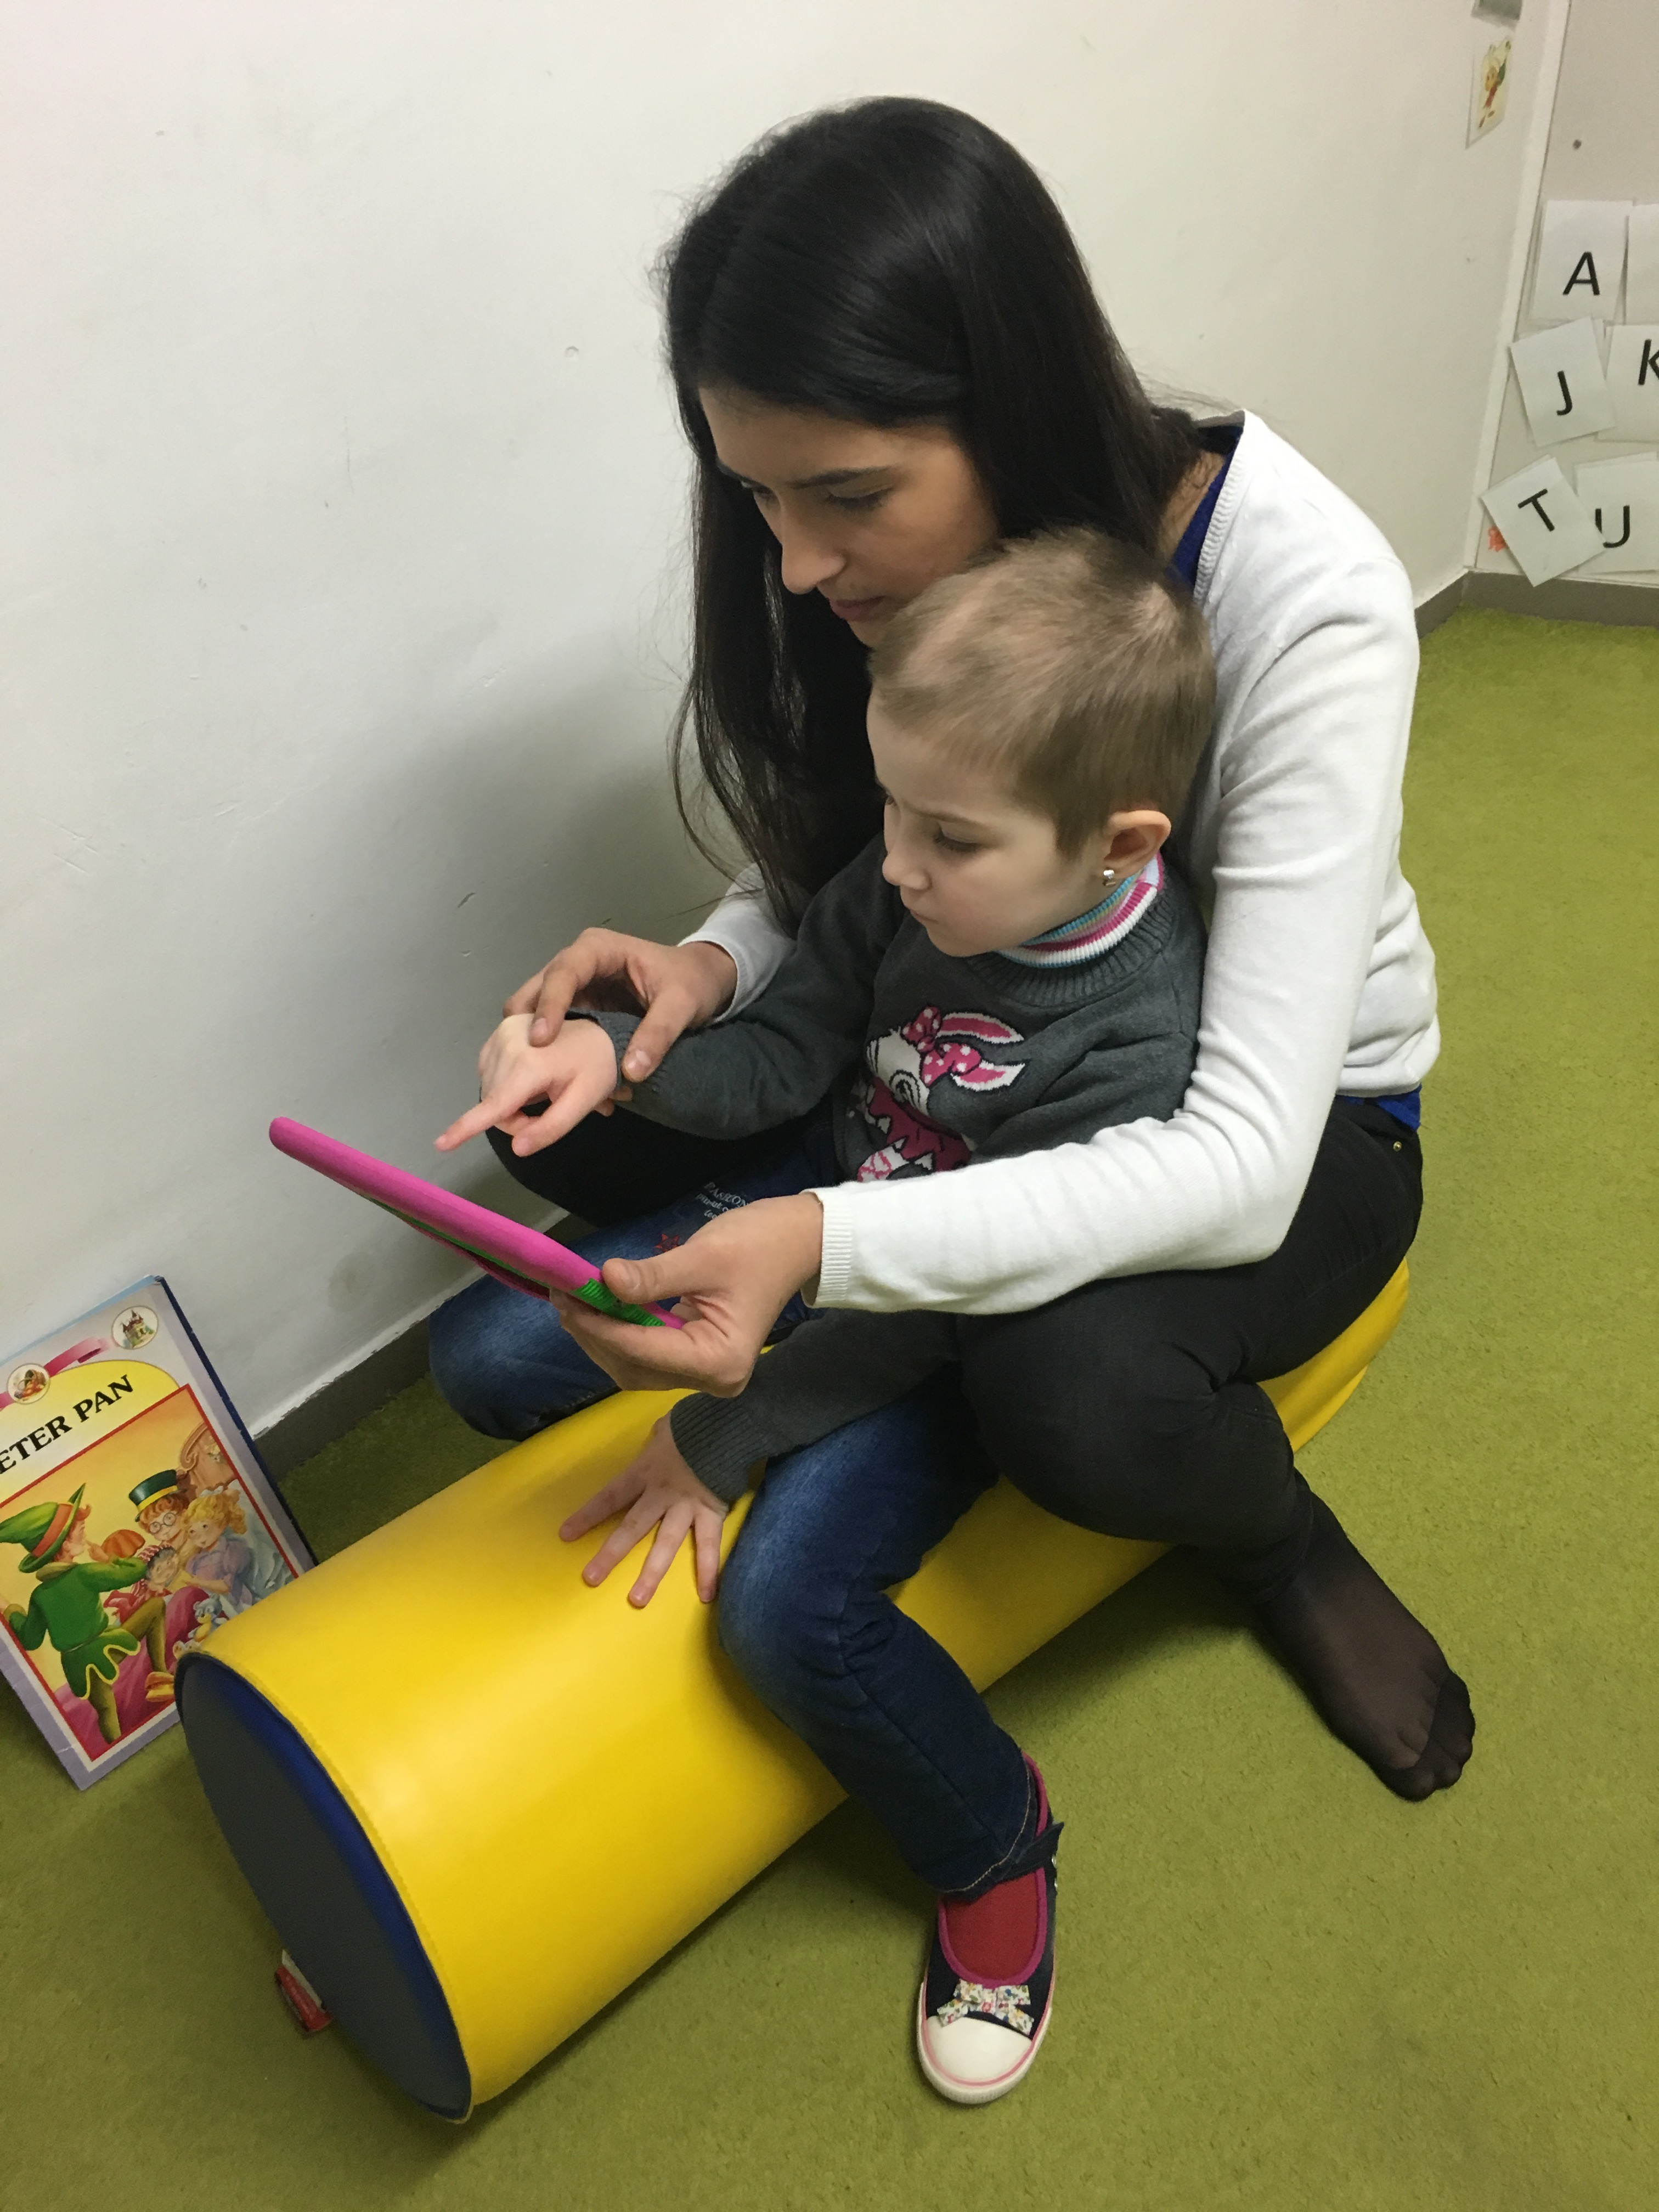

Slide 60
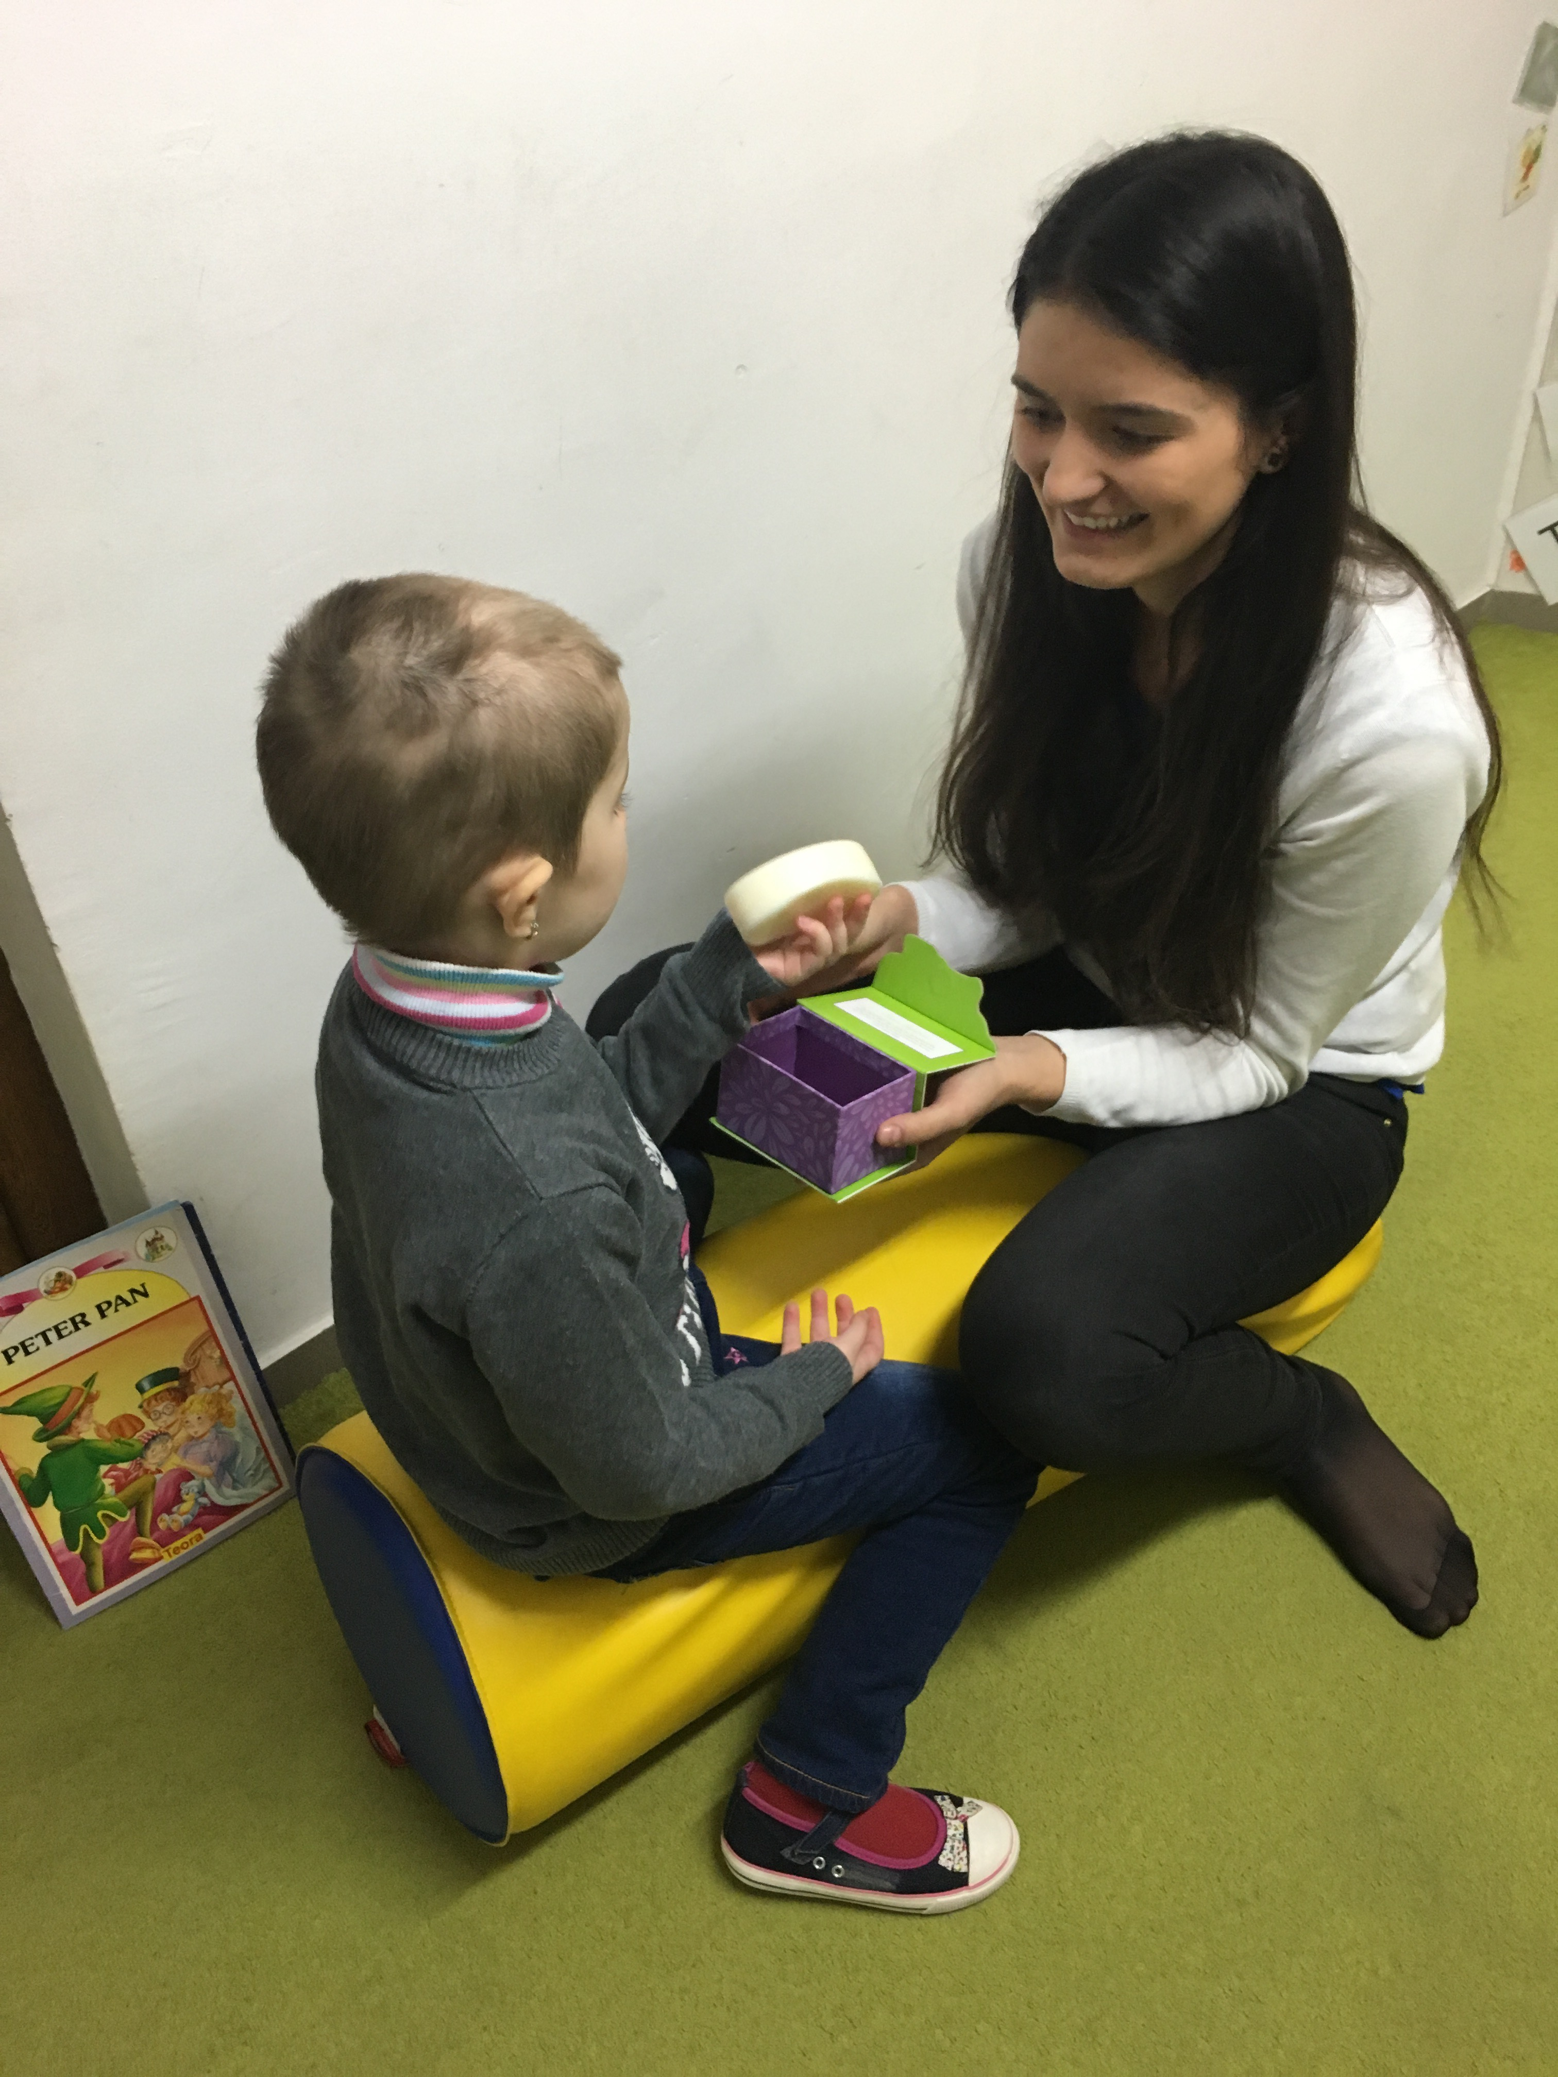

Slide 61
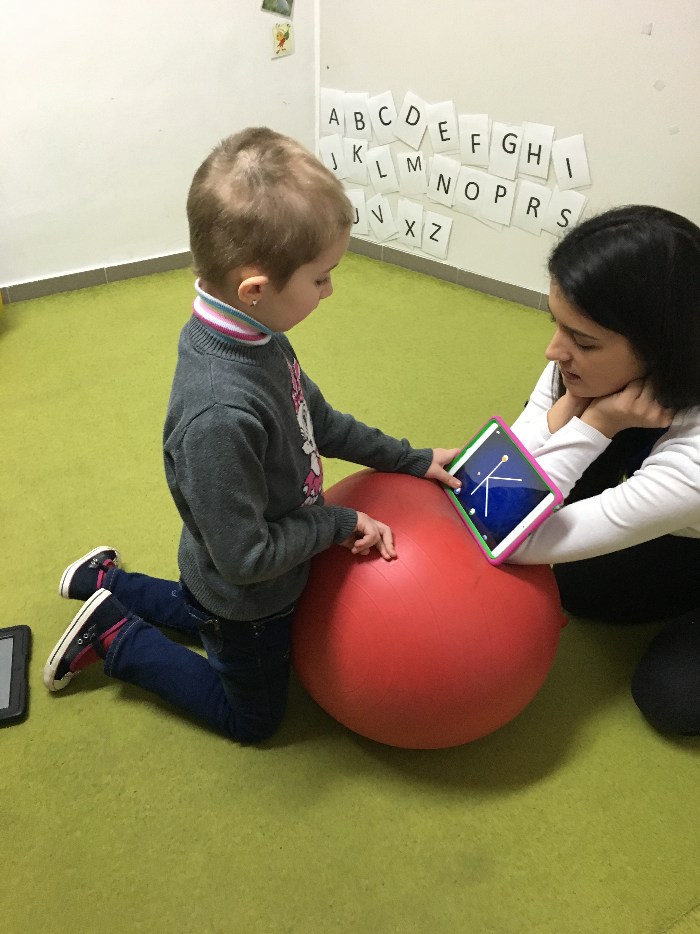

Slide 62
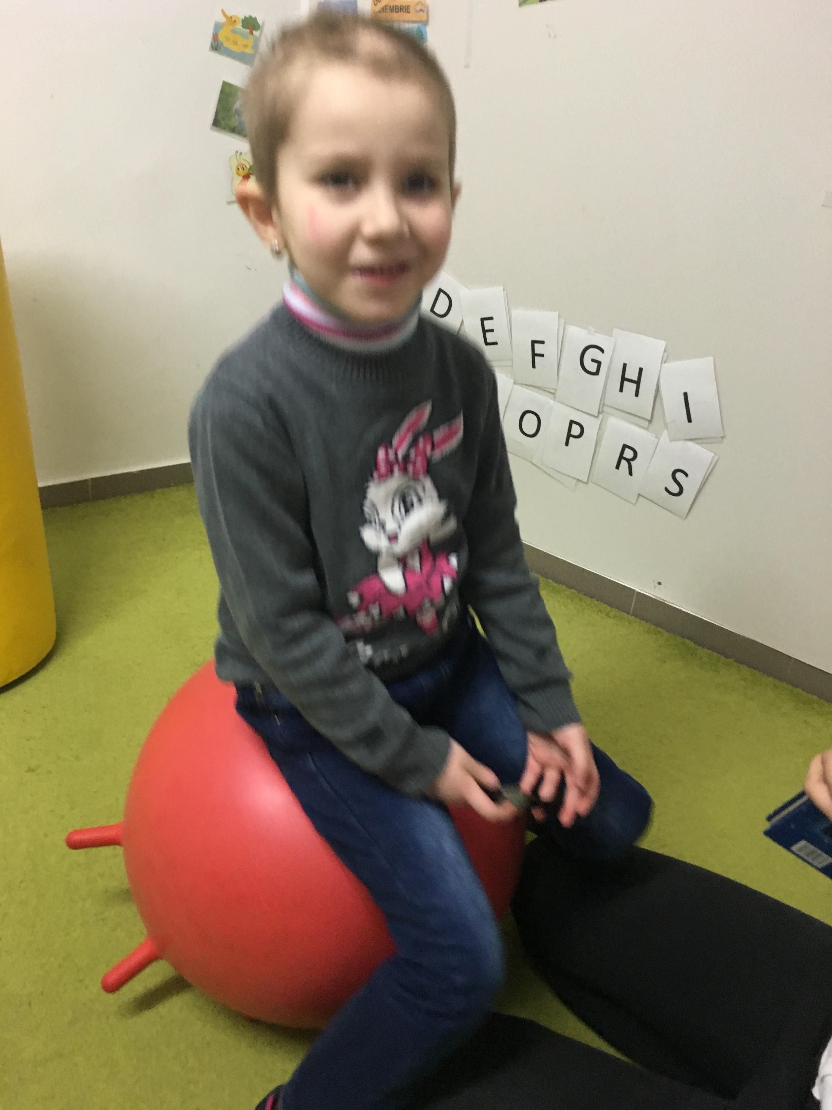

Slide 63
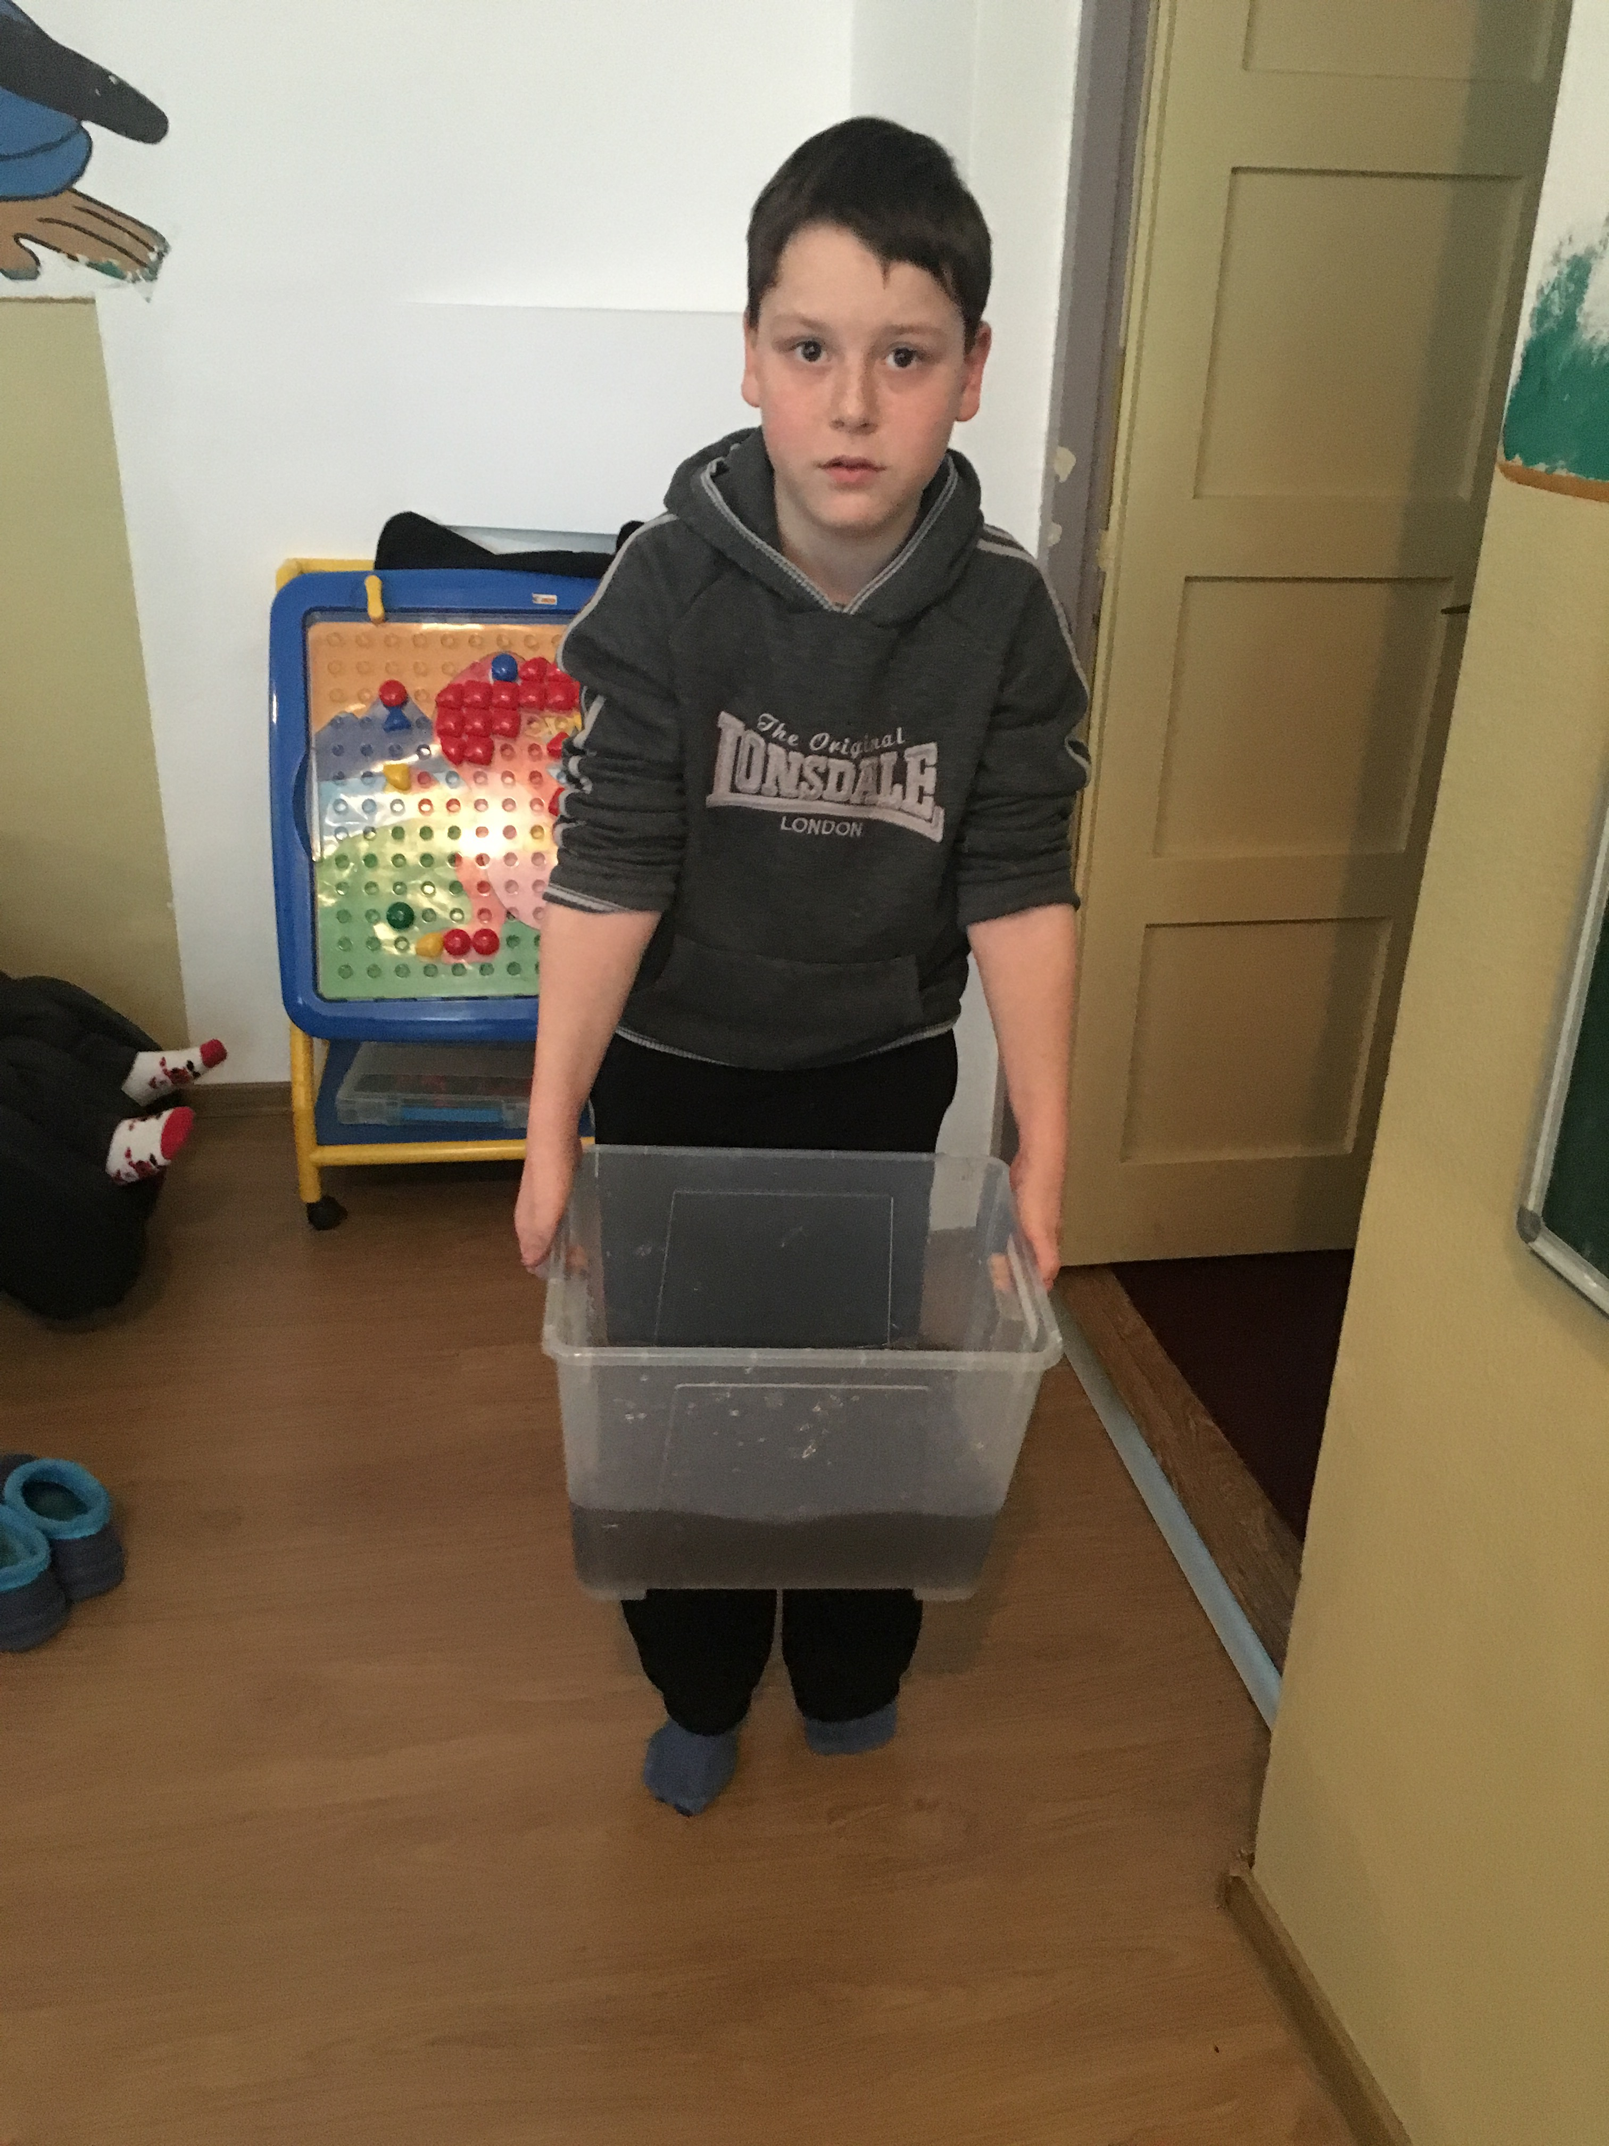

Slide 64
Strategies for Low Registration
Auditory: All environments: Use alarms/timers to give stronger cue when it is time to transition to the next activity. School: Consider where the child is sitting-placing him near more active children. If possible, allow child to listen to music with varied speeds and intensity while working. This can be done for the whole class, or by having him wear headphones. Clinic: Pair activities with music, try playing background music. Home: Explore different music, consider exploring therapeutic listening programs.
Olfactory: All environments: try using sharp/alerting smells, explore essential oils/diffuser for alerting. School: If a smell is identified that is alerting, provide child with “smell breaks” before activities requiring critical attention. Clinic: Play games where the child has to match or guess the smell, make snacks. Home: Encourage the child to participate in preparing meals, smelling pungent/sharp foods and spices.
Gustatory: All environments: Have the child explore extremes: hot/cold or sweet/sour, suck thick drinks (milkshake, yogurt, pudding) through a straw, chew gum, suck on sour candies.

Slide 65
Strategies for Low Registration
Visual: All environments: Seek eye contact from the child before trying to talk or engage him in an activity. Overall, these children need more intensive visual stimulation and a more colorful environment. School/Clinic: Use bright colors, have child write on colored paper, use a highlighter or give more clear visual boundaries, highlight or underline key information.
Tactile: All environments: Encourage others to touch the child before talking in order to gain attention. Provide tactile rich activities throughout the day. School: Use chalk, paint, markers, crayons for writing activities, use colorful manipulatives during math. Clinic: Hide objects in containers with rice/beans/pasta, write in shaving cream/sand/rice/flour/paint. Home: Rub different textures all over body, use different bath sponges, vigorously dry off the child with a towel after bath-time.

Slide 66
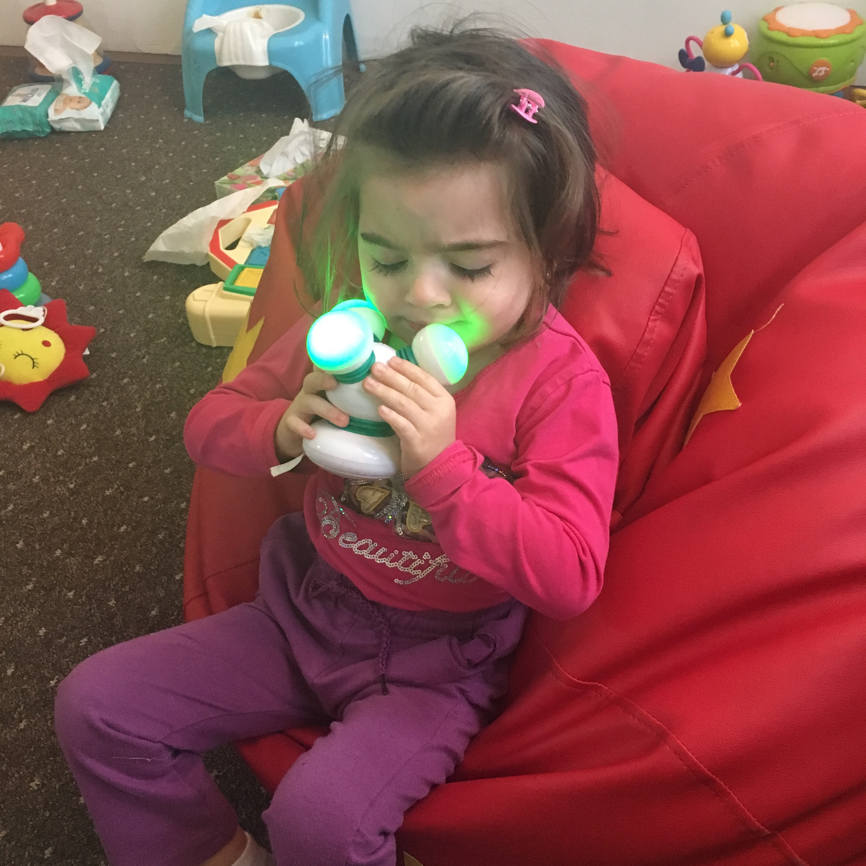

Slide 67
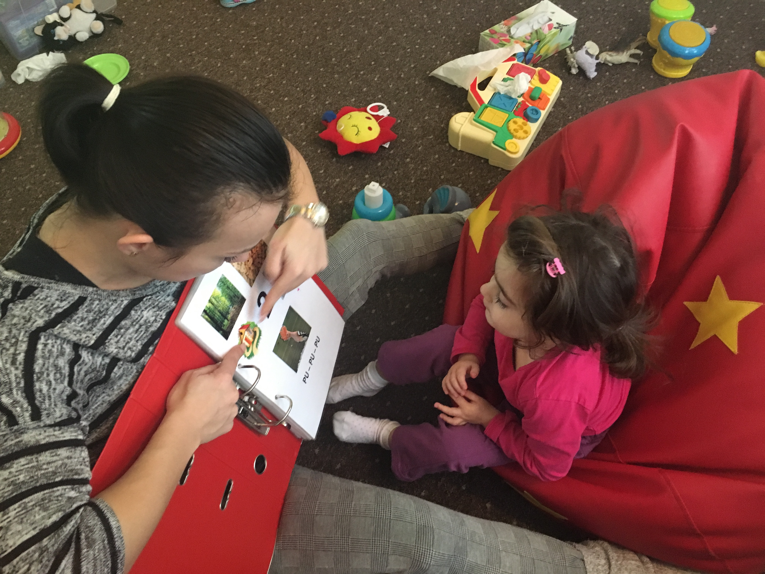

Slide 68
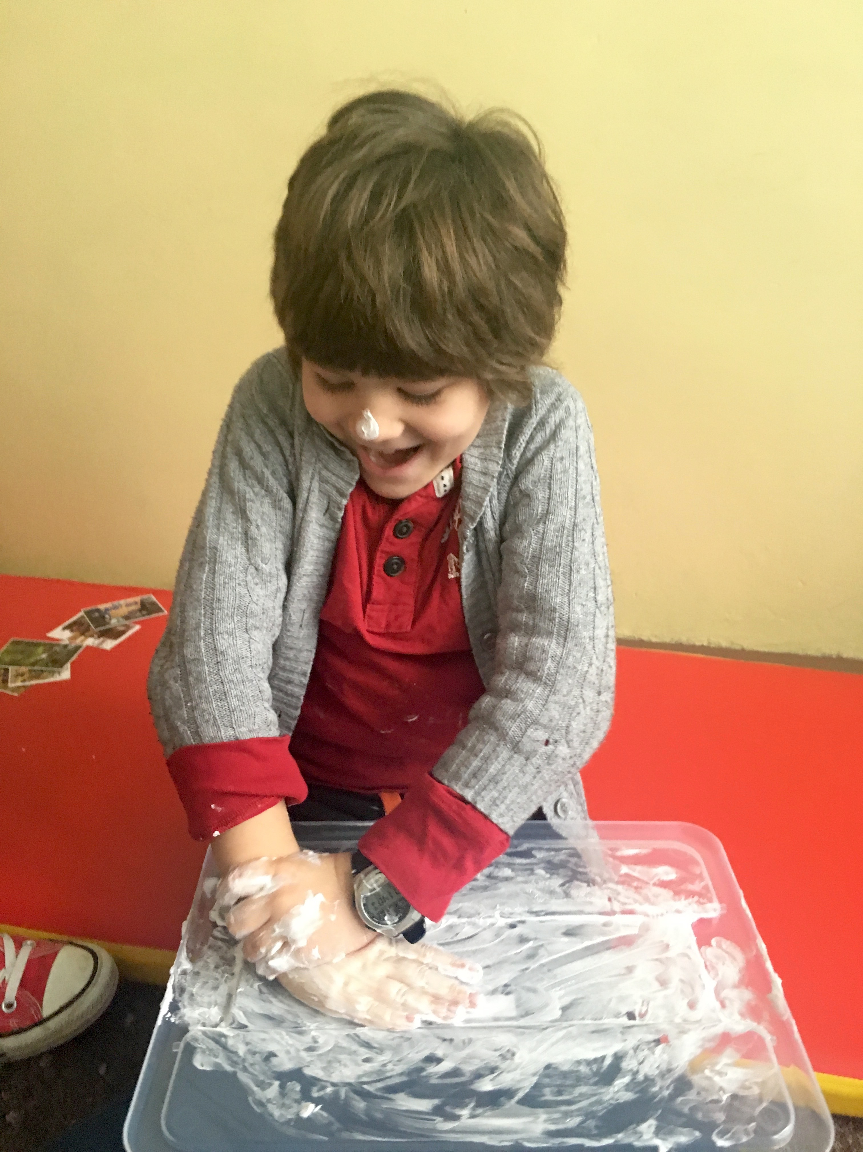

Slide 69
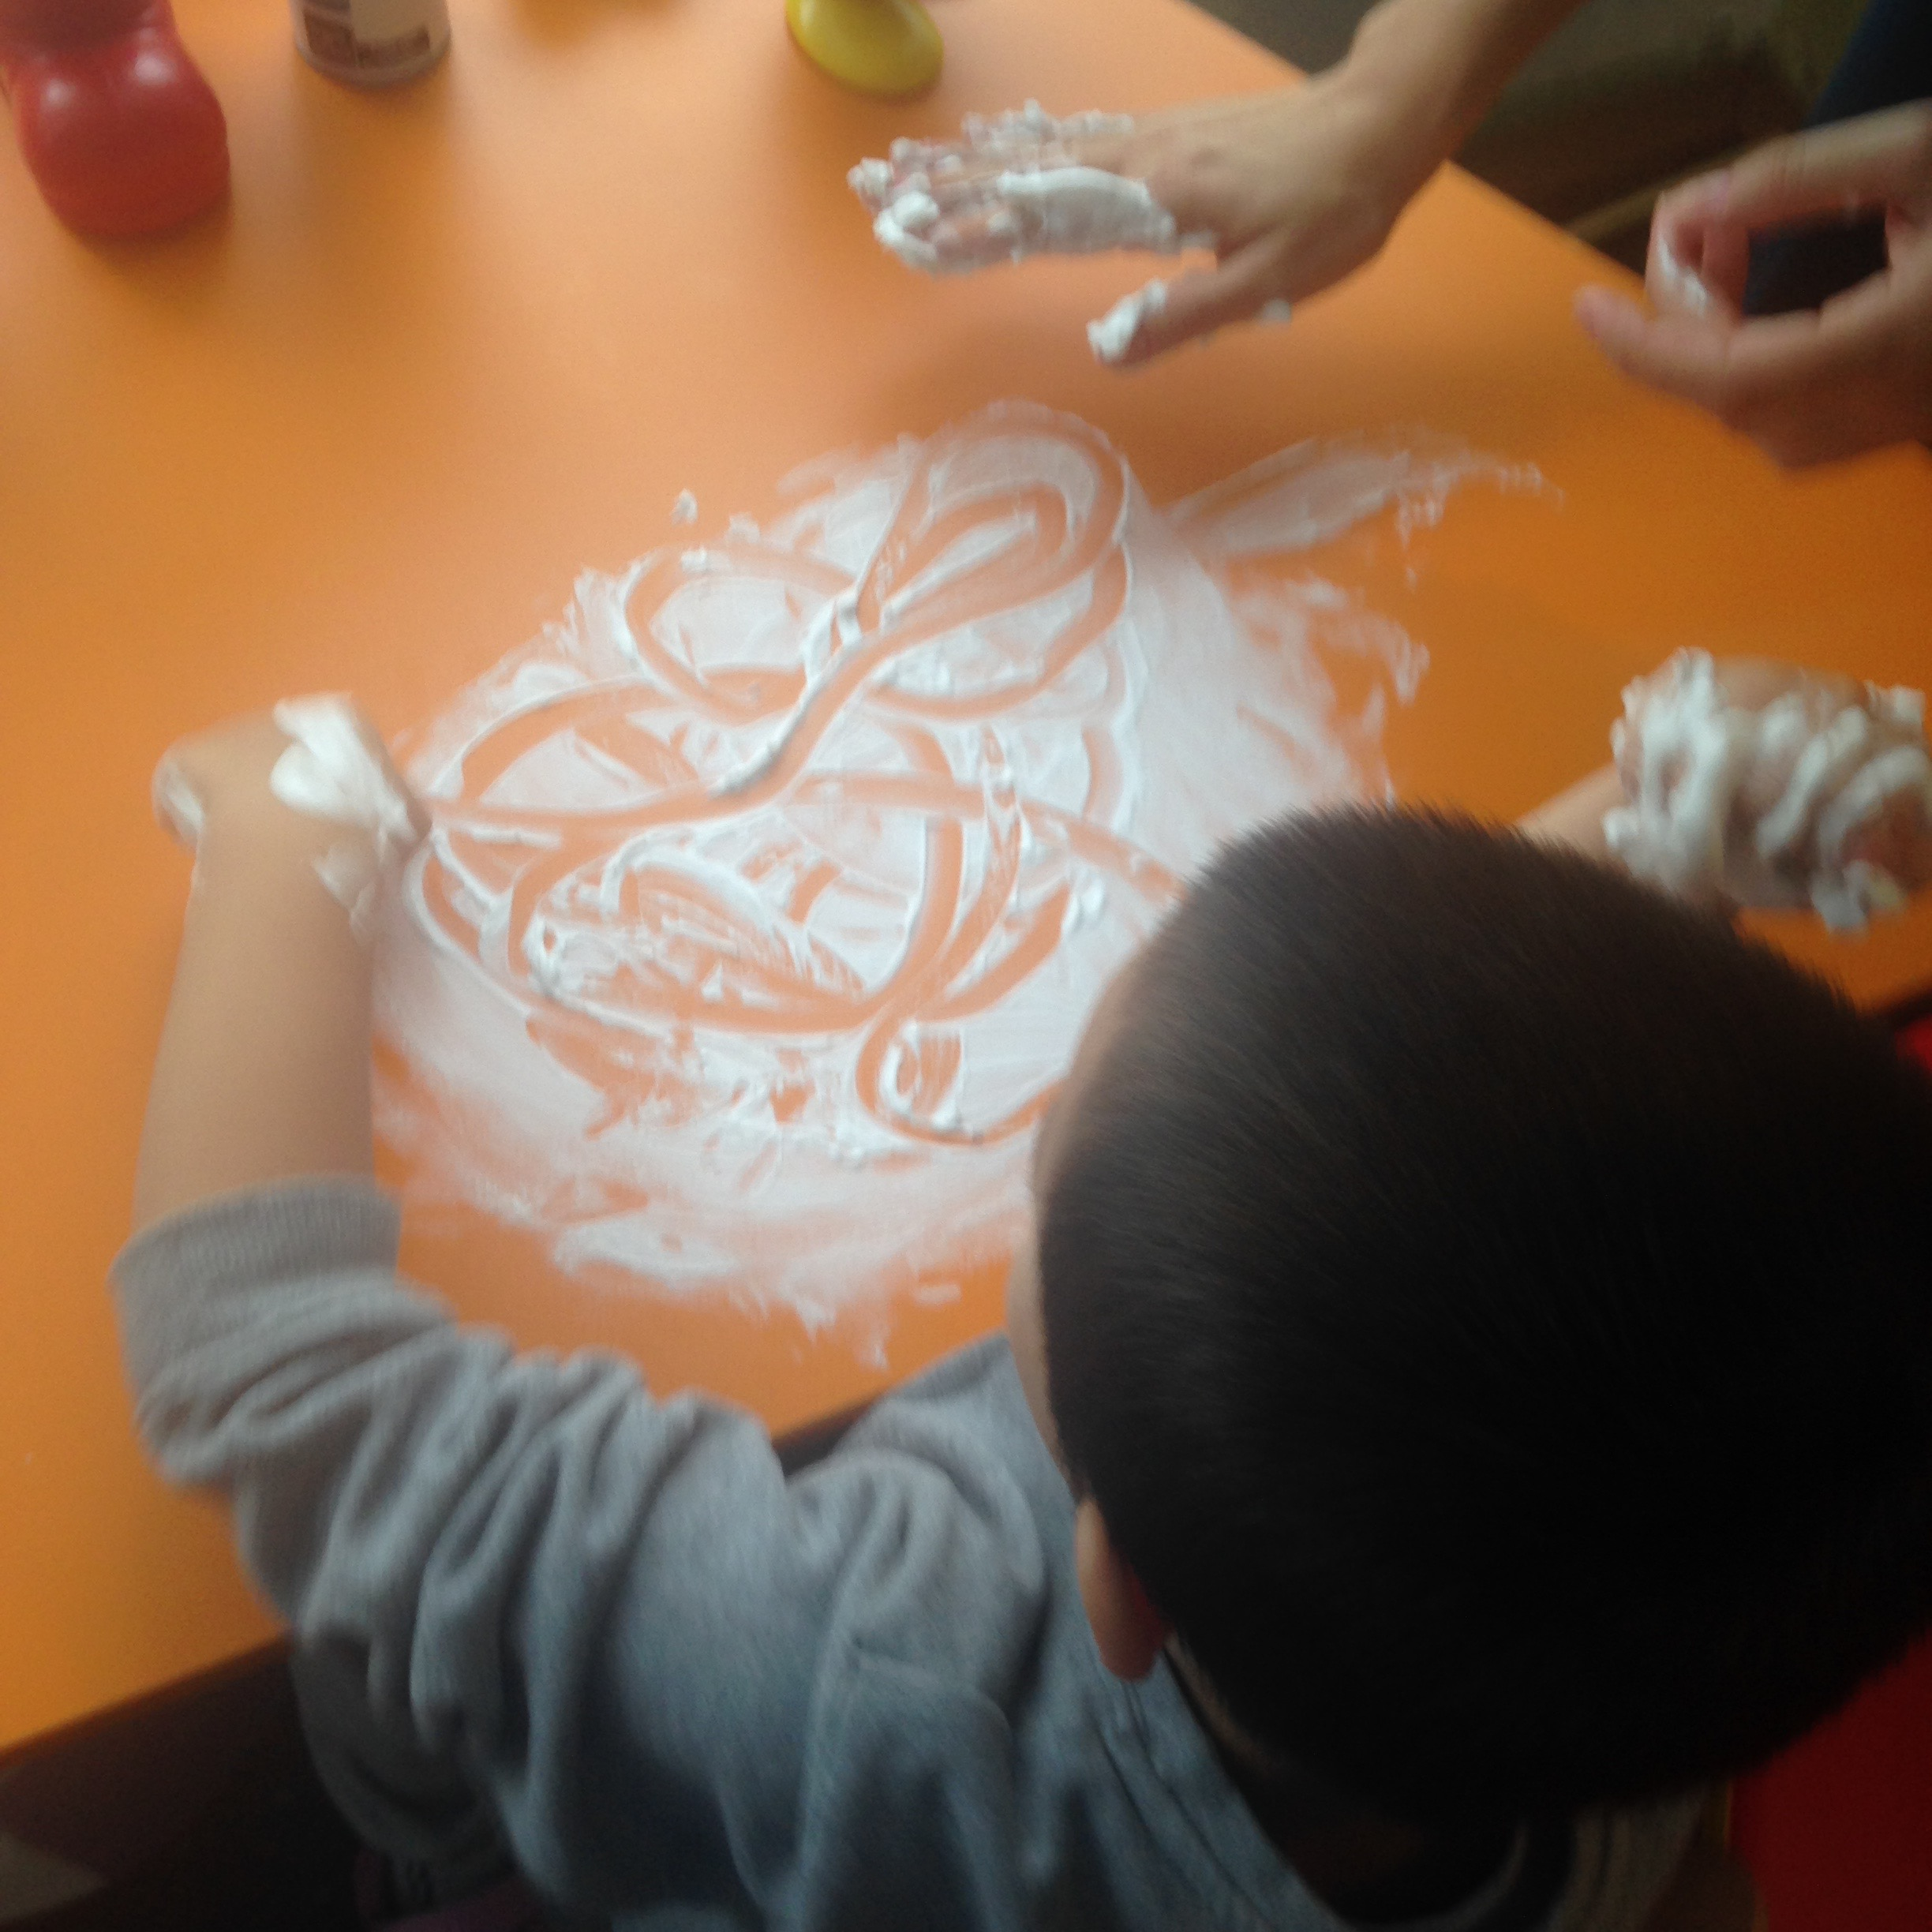

Slide 70
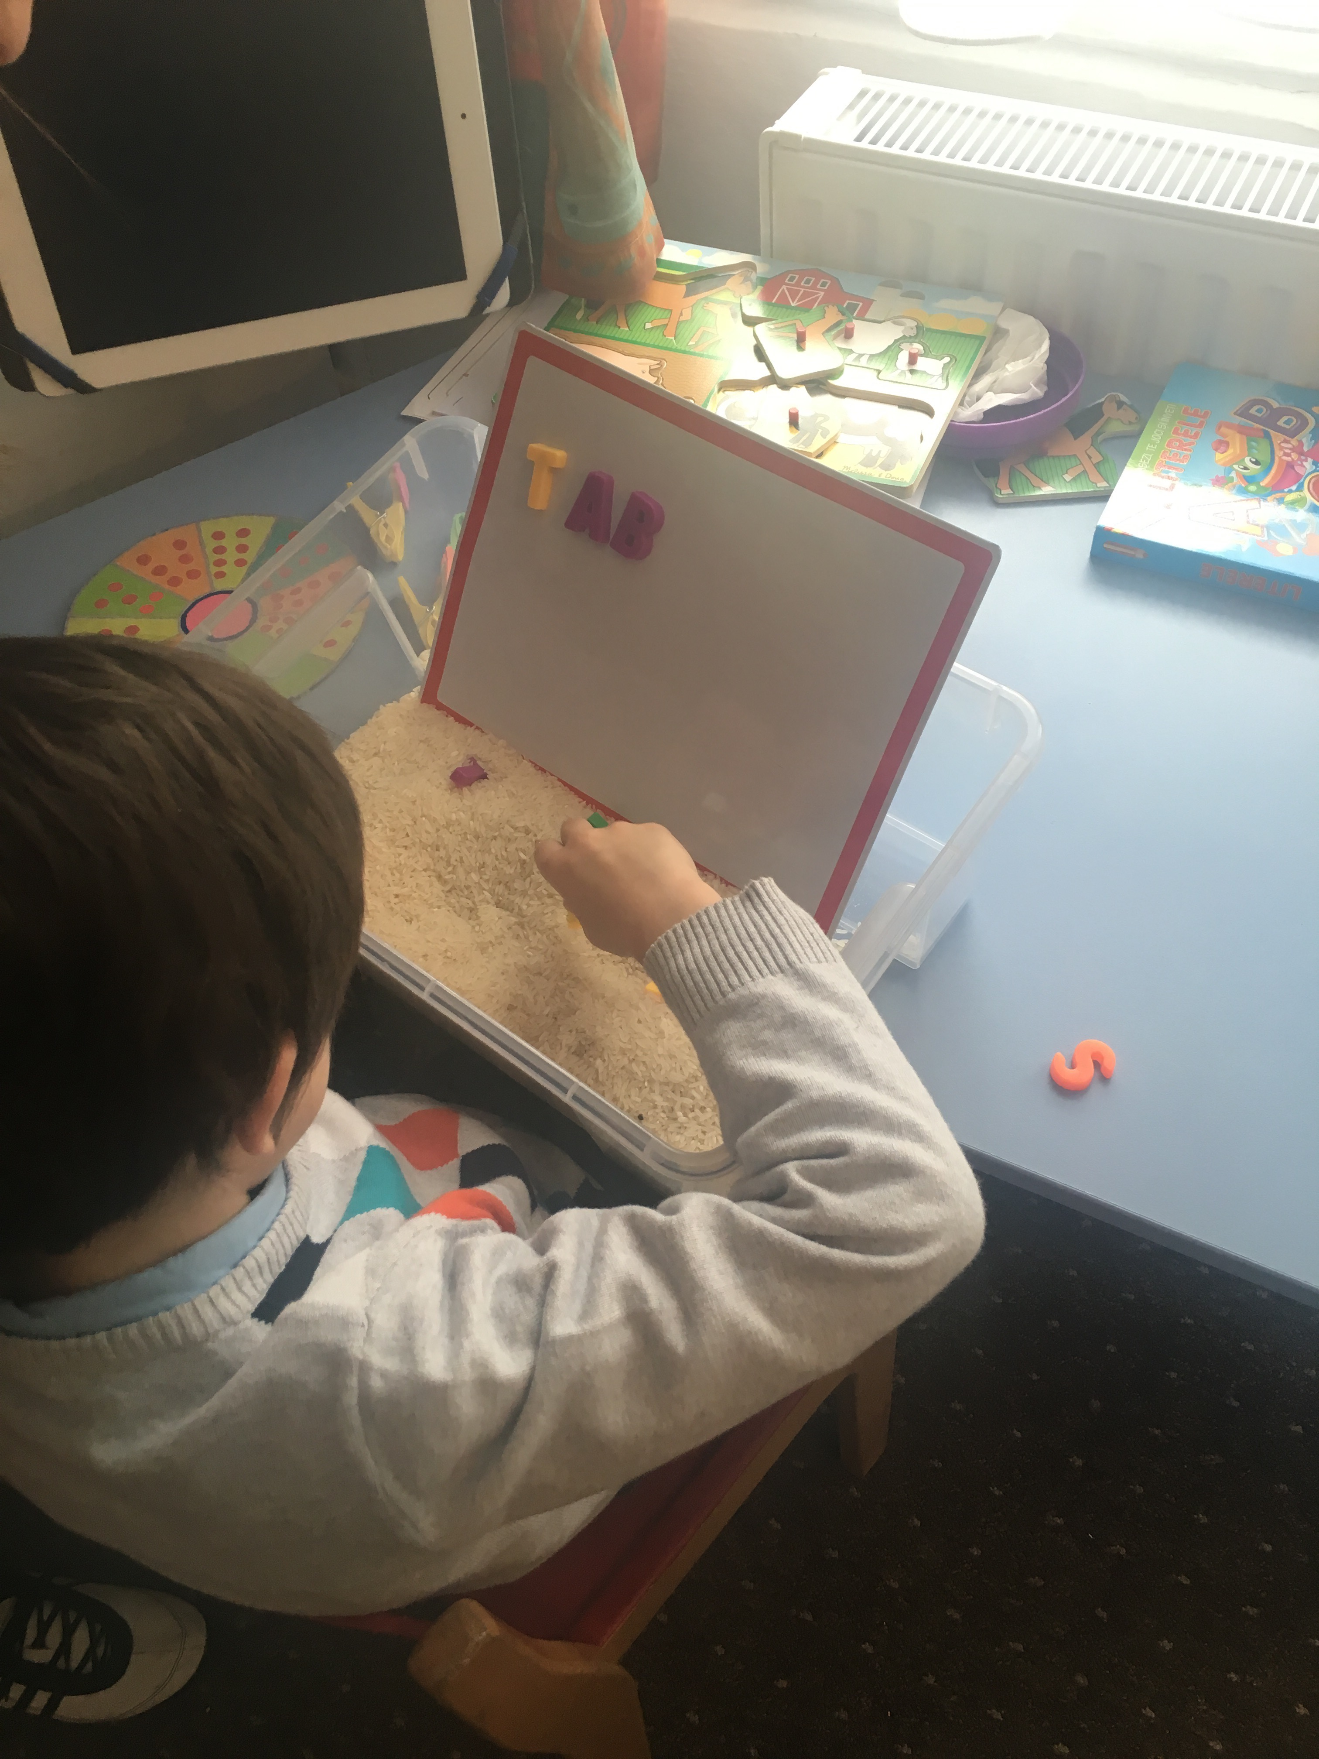

Slide 71
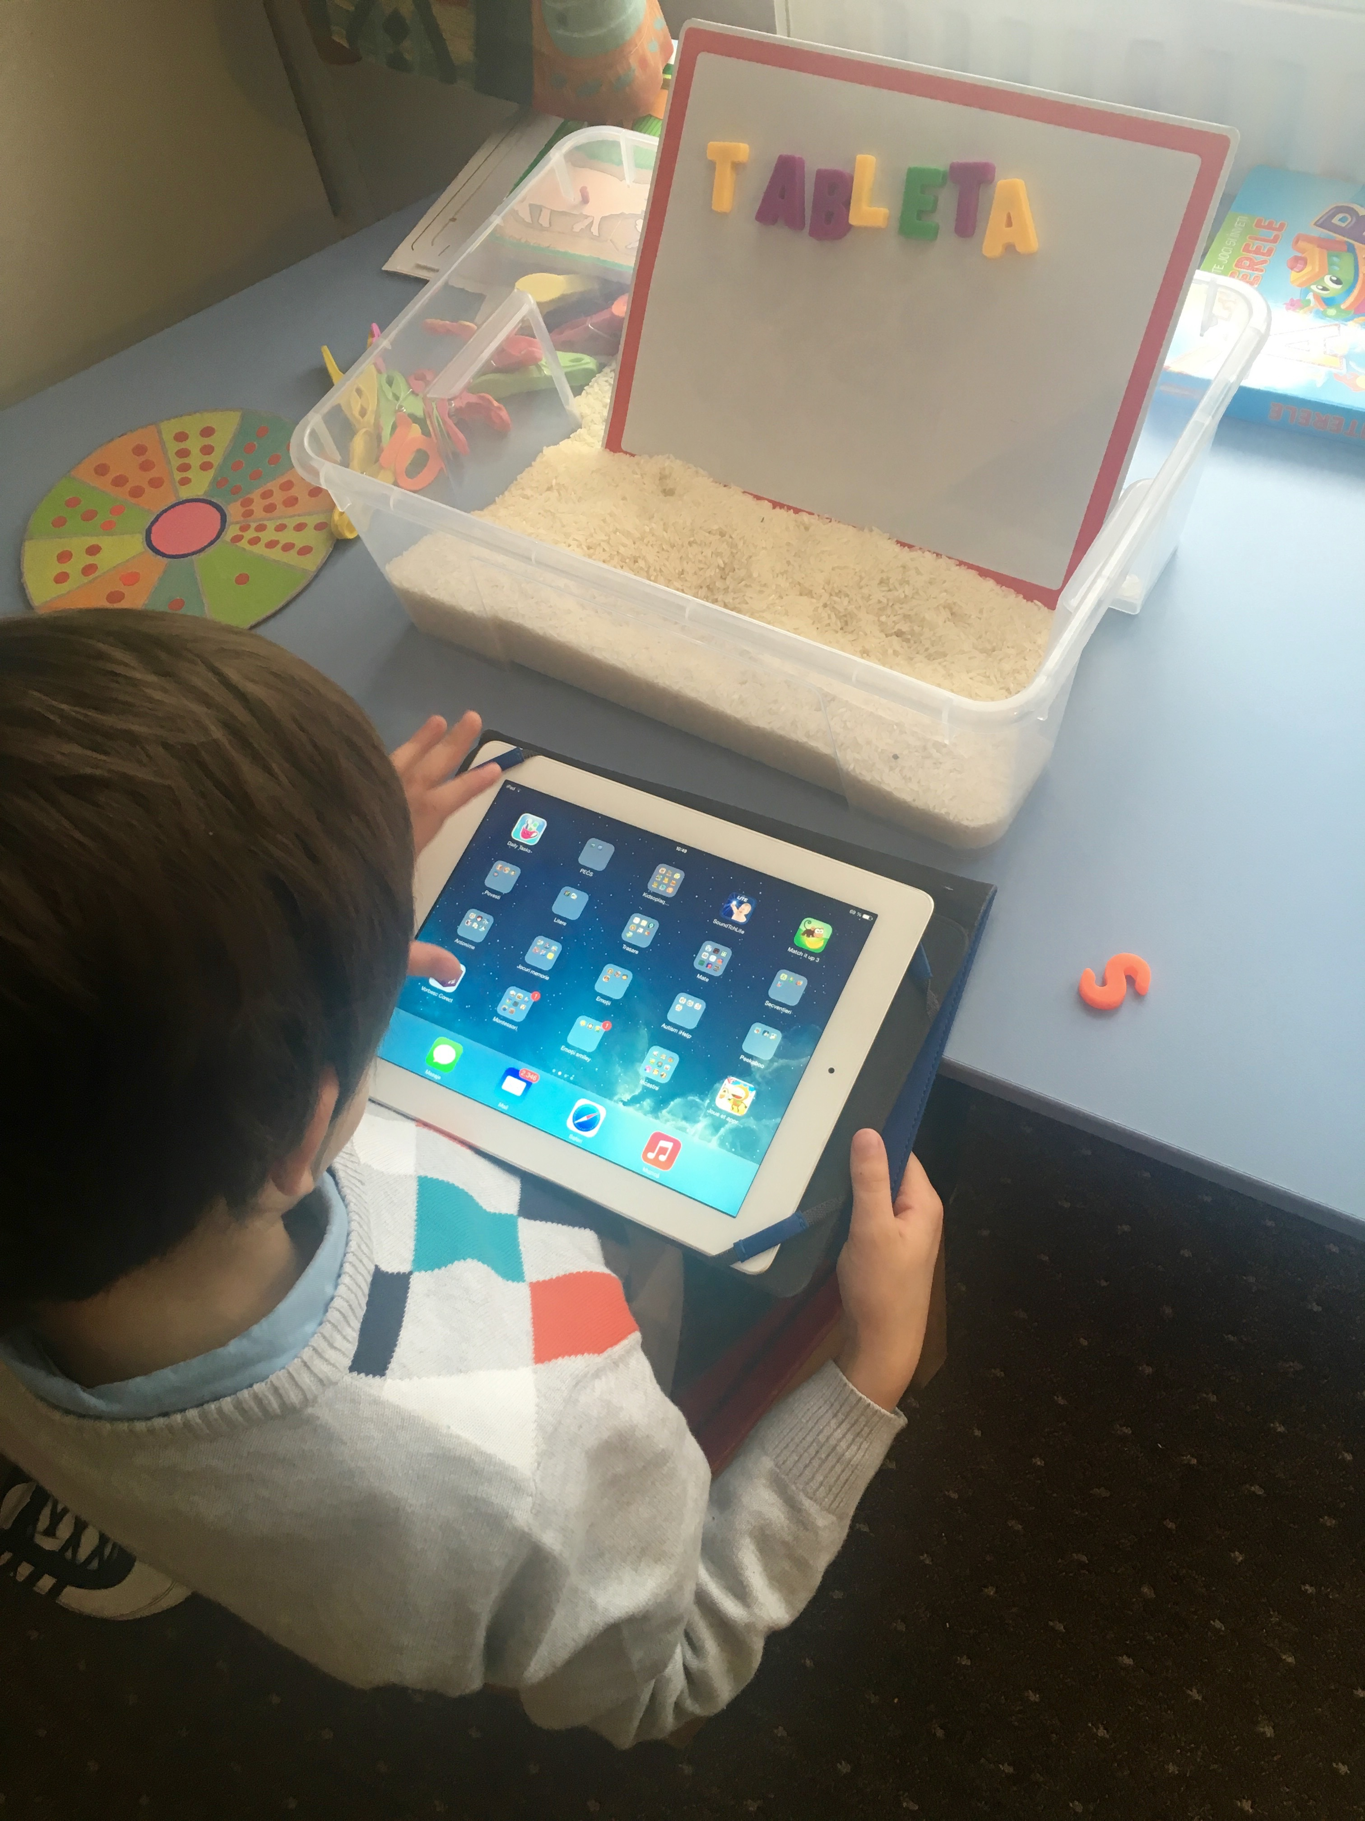

Slide 72
Strategies for Low Registration
Vestibular: All environments: These children NEED movement throughout their day. School/Clinic: Incorporate frequent movement breaks: get materials, put away materials, pass things out to classmates, sit on a therapy ball or use a sensory cushion when completing tabletop activities. Clinic: Play movement games/activities that are fast/unpredictable with quick start/stop. Encourage rotary movement (sit n spin, platform swing, tire swing). Home: Encourage outside play as much as possible, choose parks with rotary equipment, play running games with quick/unpredictable changes in direction and speed. Have child bounce on therapy ball while sitting at the table (especially if the child tends to slump).
Proprioception: All environments: Incorporate heavy work activities throughout the child’s day. School: cleaning tables, whiteboard/chalkboard, stacking chairs, carrying heavy books, wall push ups, chair push ups. During recess, encourage climbing on a jungle gym, playing tug-of-war, jumping games. Clinic: Gathering/putting away materials, jumping on trampoline, push/pull games, climbing on a jungle gym, animal walks, theraband exercises. Home: Animal walks from room to room, wheelbarrow walking, jumping on a trampoline or bed, house chores- vacuuming, sweeping, taking out garbage, carrying laundry basket.

Slide 73
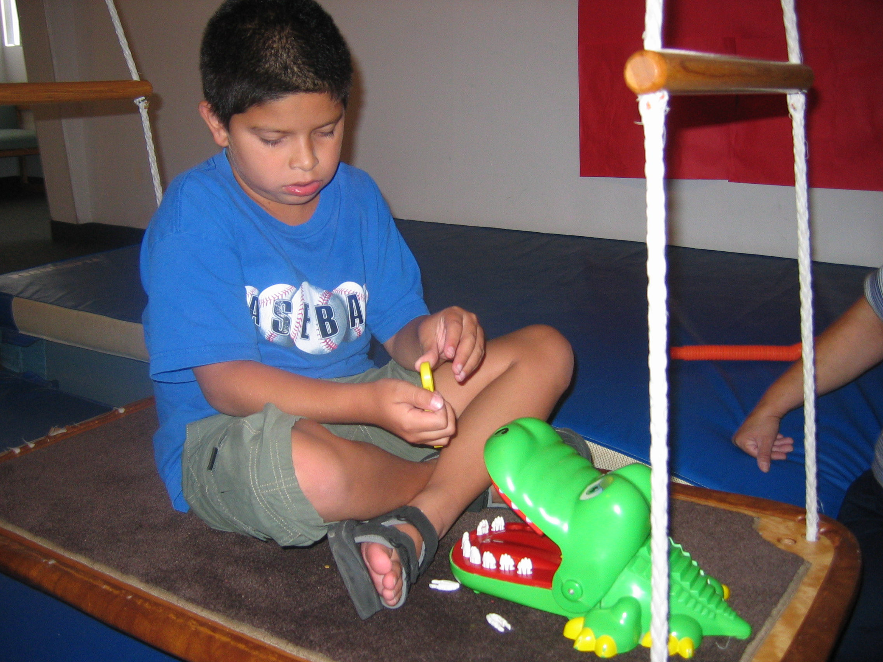

Slide 74
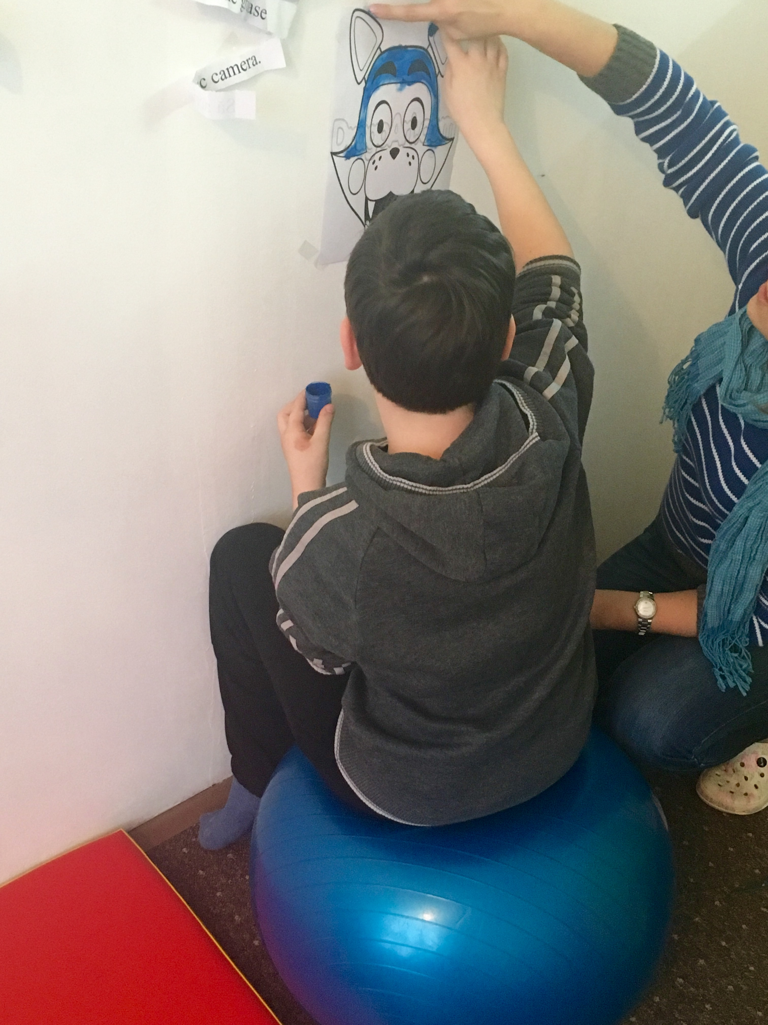

Slide 75
Strategies for Sensory Seeking
Note: Many of these activities are similar to ones listed under Low Registration; however, the difference will be in the intensity and duration of the sensory input provided.
Many children who demonstrate sensory seeking behaviors benefit from the use of a visual schedule. This helps him to know when more movement activities will happen, or how many activities he needs to accomplish before getting a sensory break.
These children often need help choosing correct activities when given a sensory break. The use of sensory choice boards can be very helpful in guiding the child to make decisions on what activities will best help him become calm and organized.

Slide 76
Strategies for Sensory Seeking
Olfactory: All environments: have child explore essential oils and determine ones that help the child calm. School: If a smell is identified that is calming, consider using it in a diffuser. Offer child “smell breaks” to help child calm before engaging in activities. Clinic: Play games where the child has to match or guess the smell, make snacks. Home: Encourage the child to participate in preparing meals, smelling various spices.
Gustatory: All environments: Offer foods with lots of flavor, intense tastes, offer variety of textures, have child drink through straw, provide thickened liquids for more intensity.

Slide 78
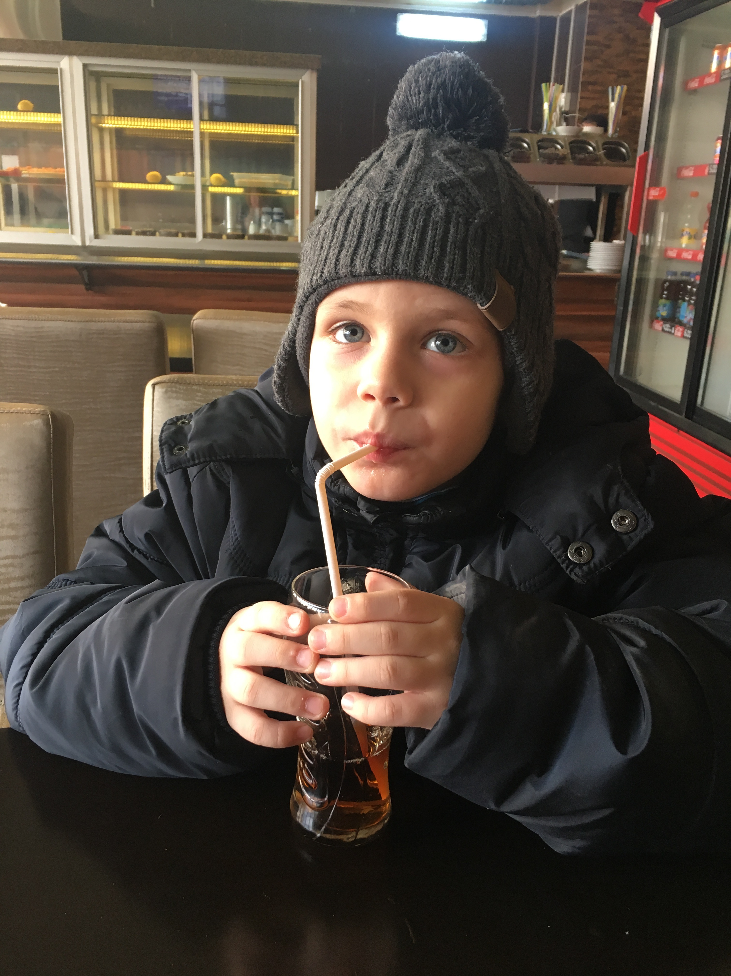

Slide 79
Strategies for Sensory Seeking
Auditory: School: If possible, allow child to have background music when working, use headphones. Clinic: Consider exploring different listening programs. Home: Allow child to explore different types of music, use headphones to increase intensity.
Visual: School: Minimize clutter in classroom, keep materials organized at desk to limit visual distractions (may need to provide visual supports). Clinic: If child is seeking visual input, increase the intensity by pairing the input with more demands (for example, child has to find the colored balls hidden in room and then throw the balls at a target), Child should ideally be seen in a room with limited visual distractions. Use containers, dividers, curtains to limit visual distractions. Home: Minimize clutter by keeping objects in containers, in closets/drawers.
Visual: Minimize clutter, organized materials at desk, in closets/drawers

Slide 80
Strategies for Sensory Seeking
Tactile: School: Offer child fidget toys (teach rules for use), place a velcro strip under the desk, have the child wear an elastic bracelet, provide deep pressure throughout the day, consider having the child wear a compression vest. Add tactile experiences into the child’s school routine, such as introducing a “texture of the week” during circle time. Clinic: Allow child to use fidget toys when possible. Incorporate “tactile breaks” into his session, offering deep pressure squeezes/making a sandwich/sarmale, provide tactile play, but again increase the demands by having him do more structured activities with the tactile substance (such as making shapes with play-dough or sand, writing spelling words in shaving cream or salt, finding objects buried in sensory boxes and then sorting or labeling). Home: Encourage tactile play with boundaries (example: painting in designated areas, writing out spelling words in salt/sugar/flour, lotion rubs after bath time (can be followed by joint compressions).

Slide 81
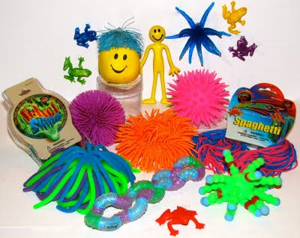
Examples of Fidgets

Slide 82
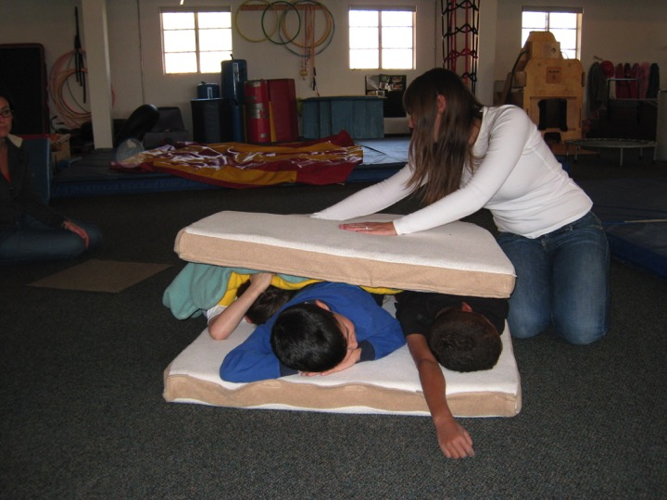

Slide 83
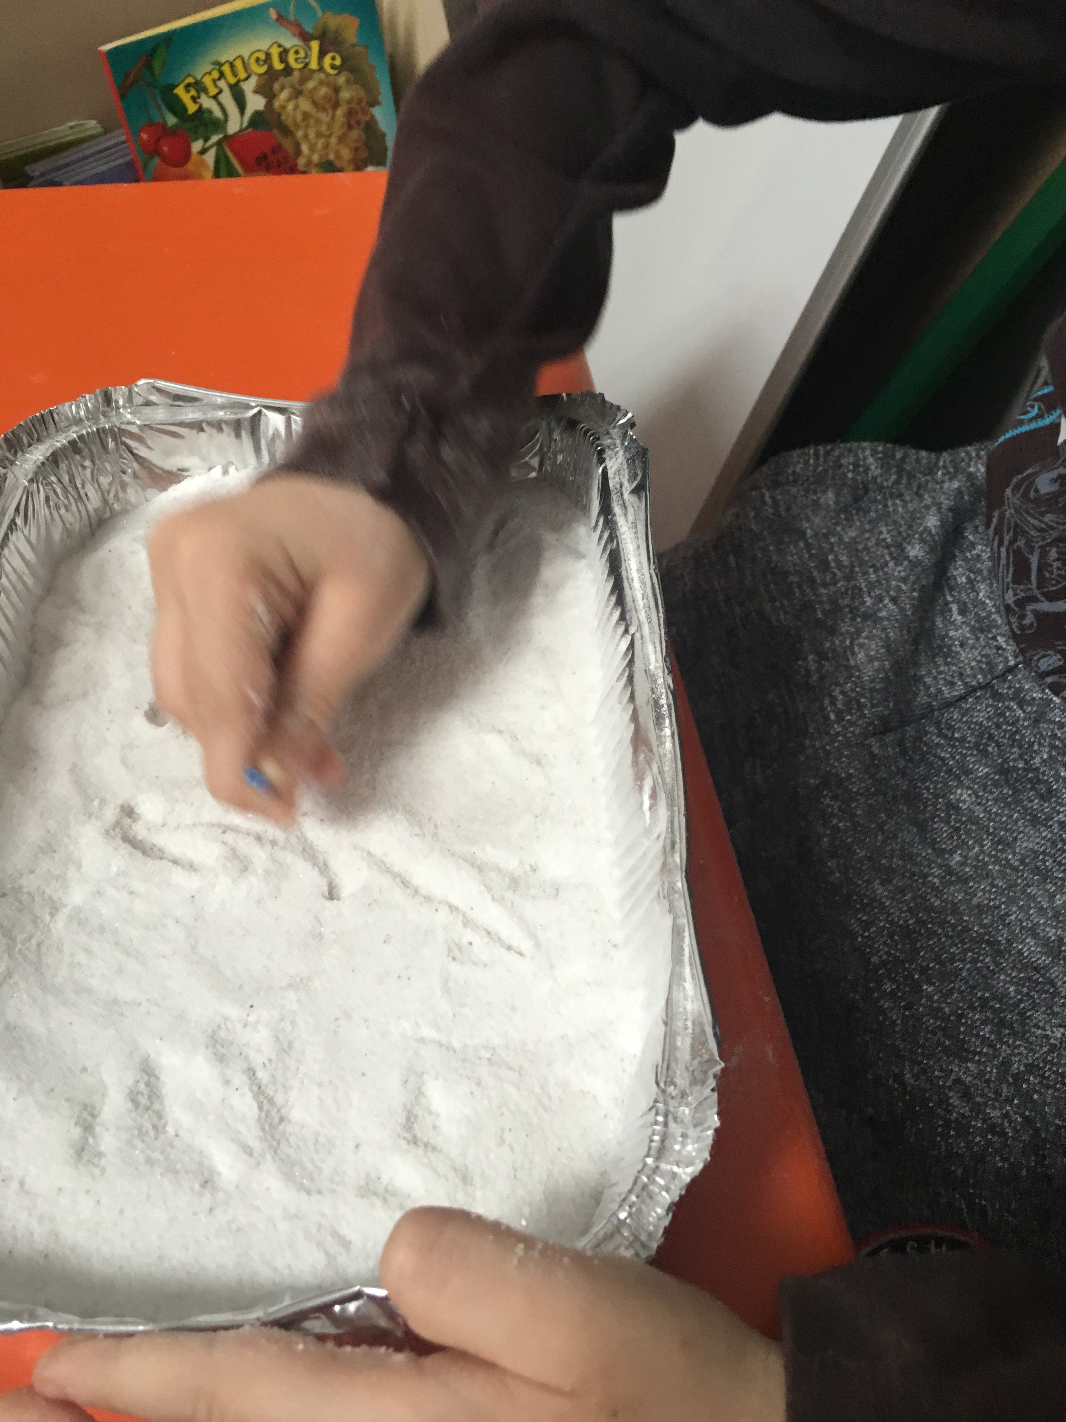

Slide 84
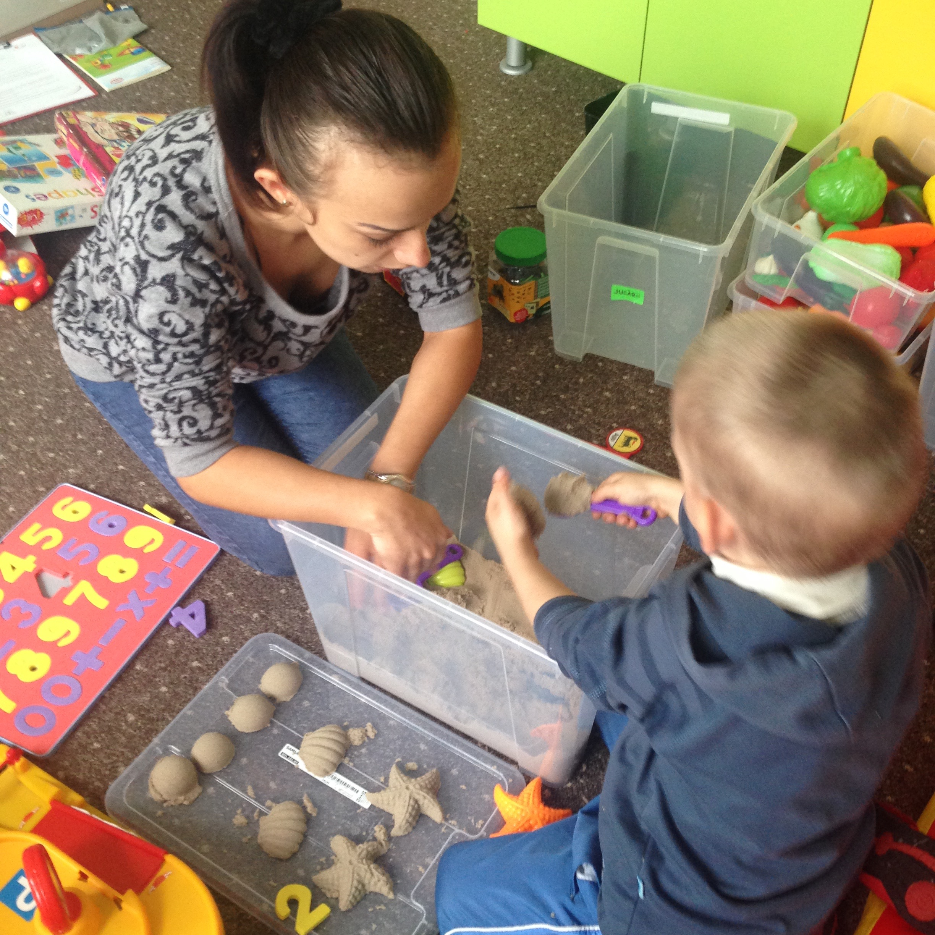

Slide 85
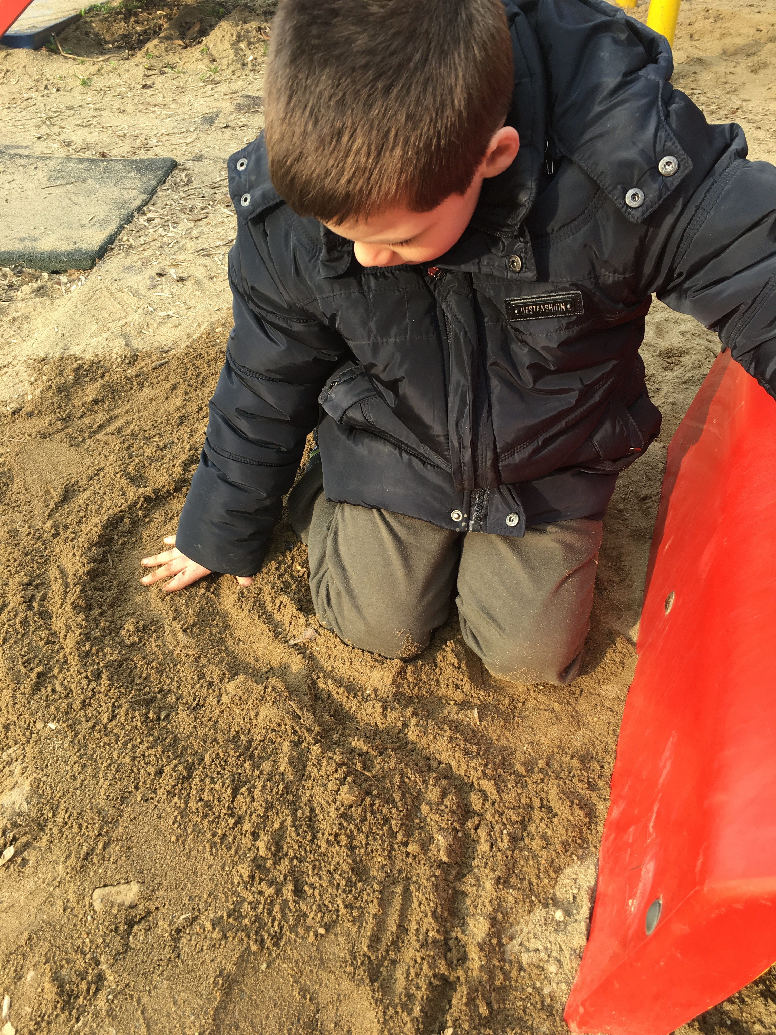

Slide 87
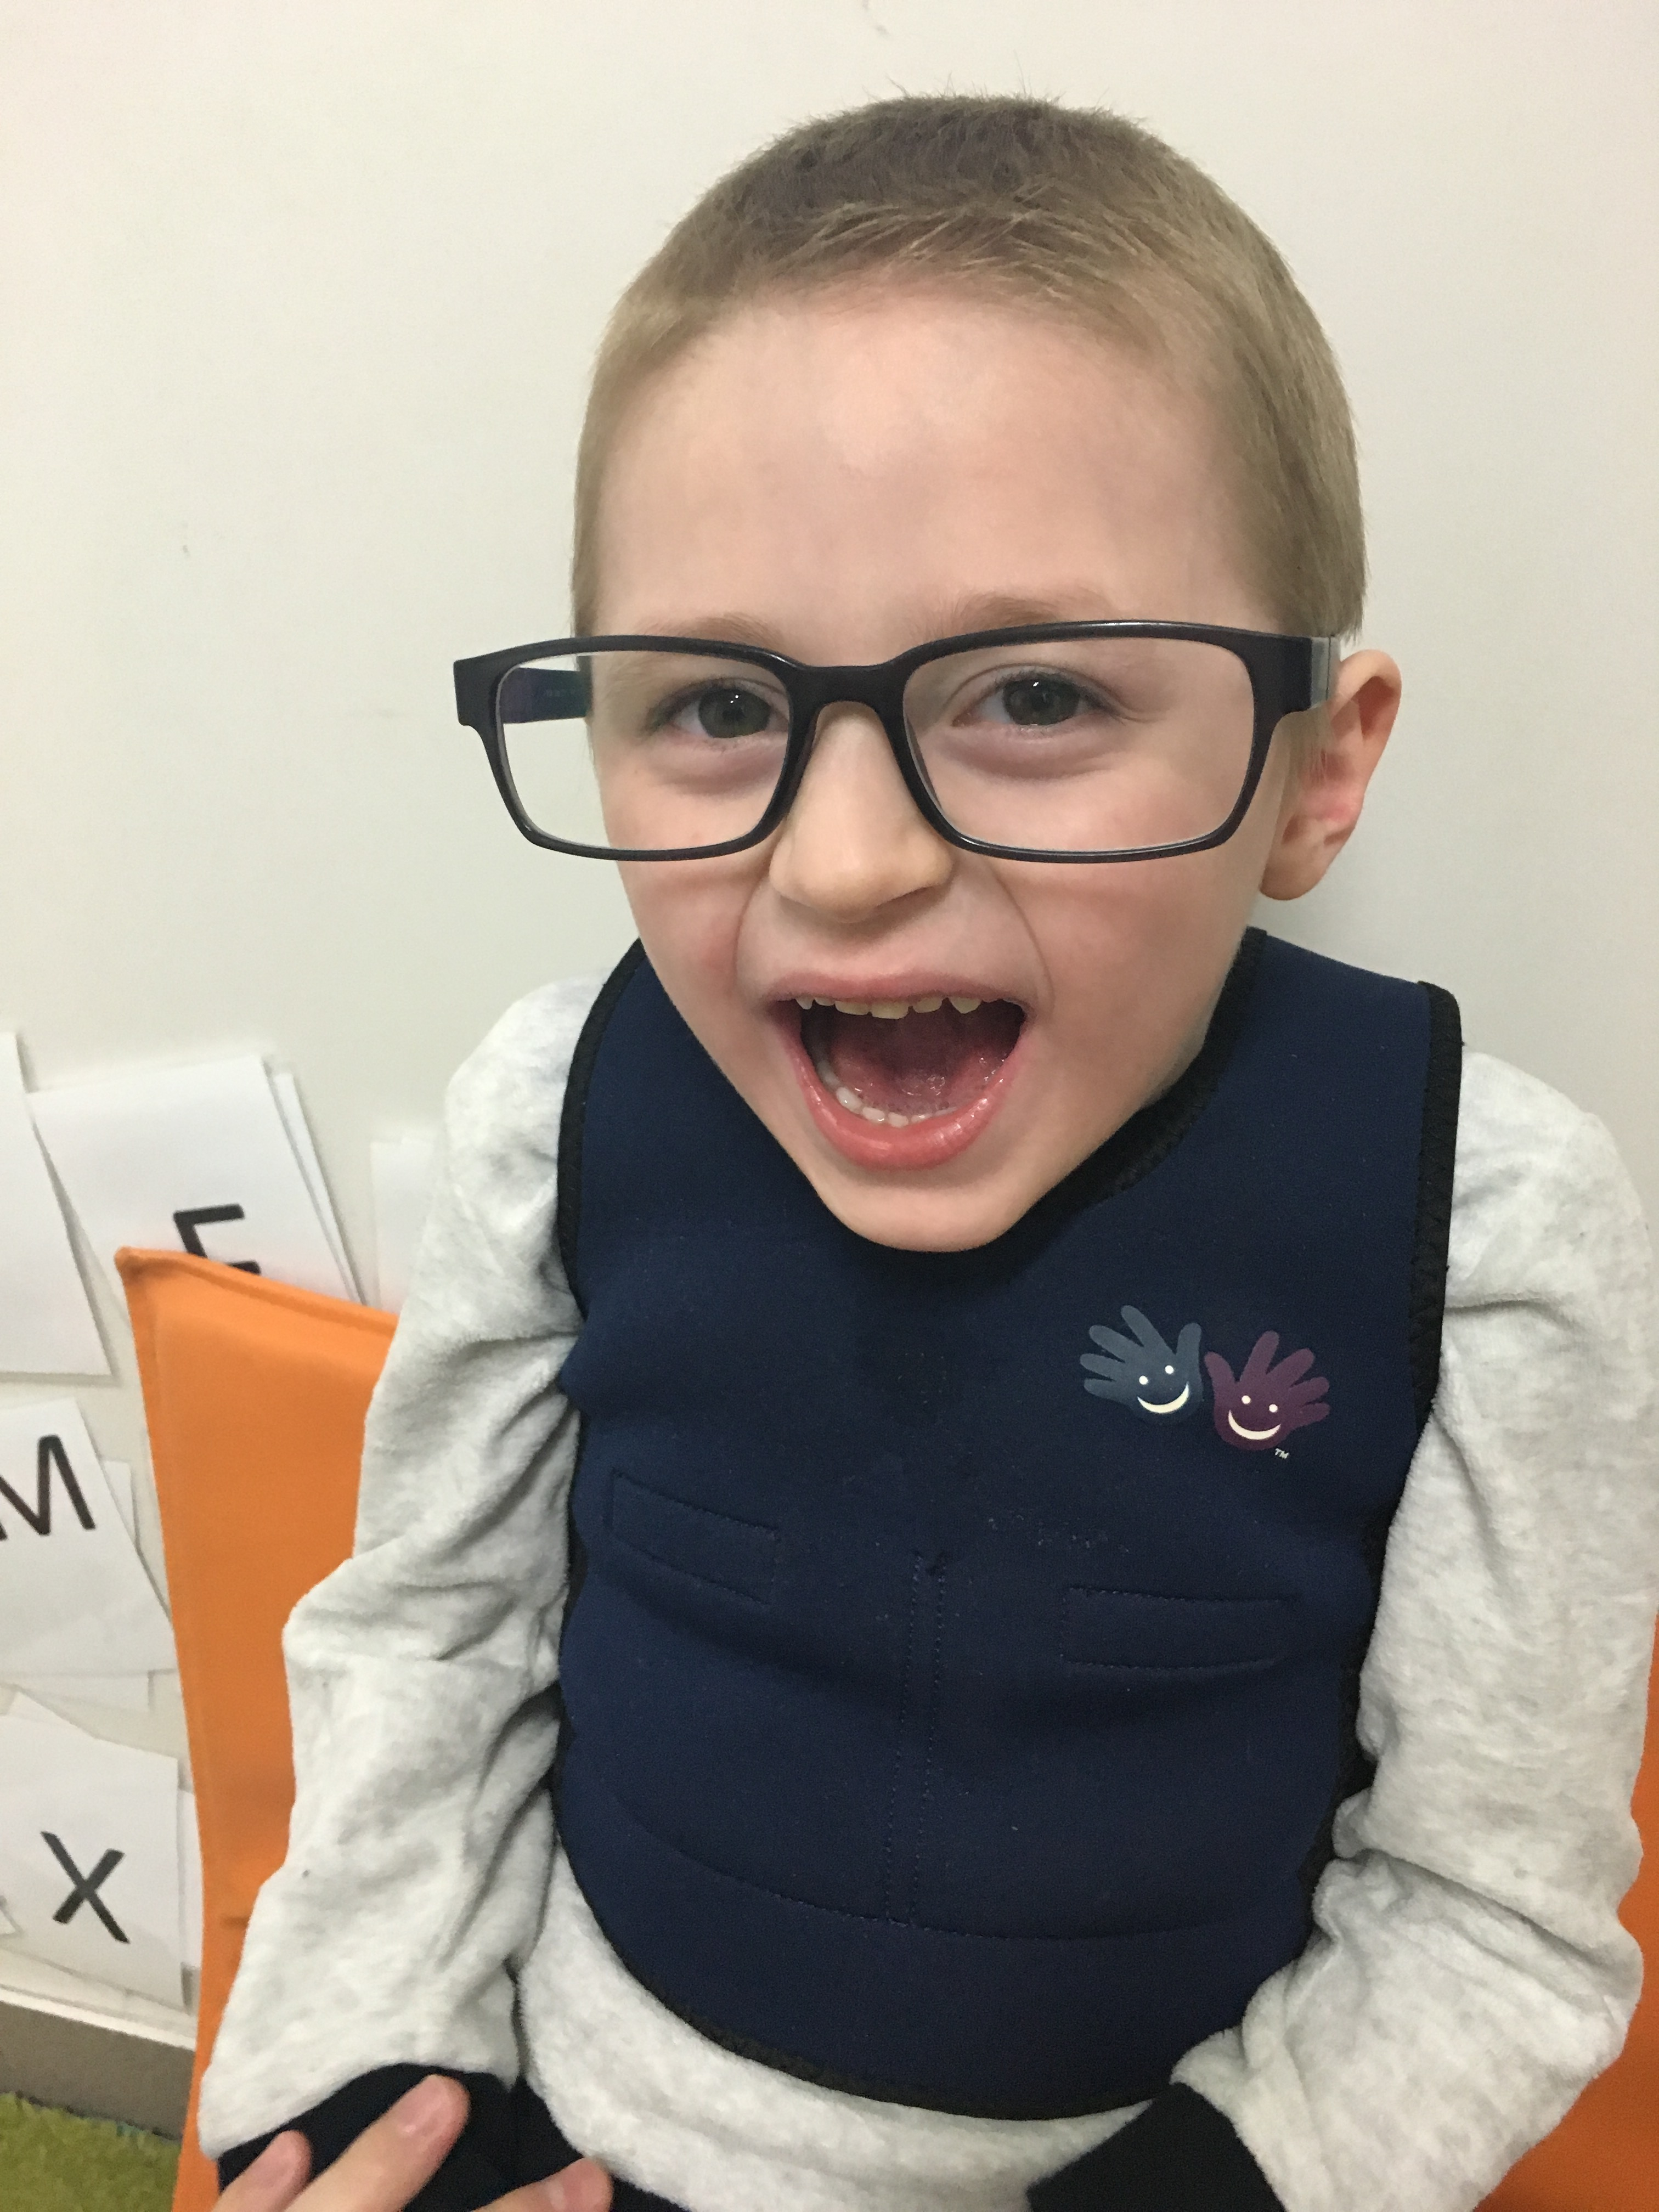

Slide 88
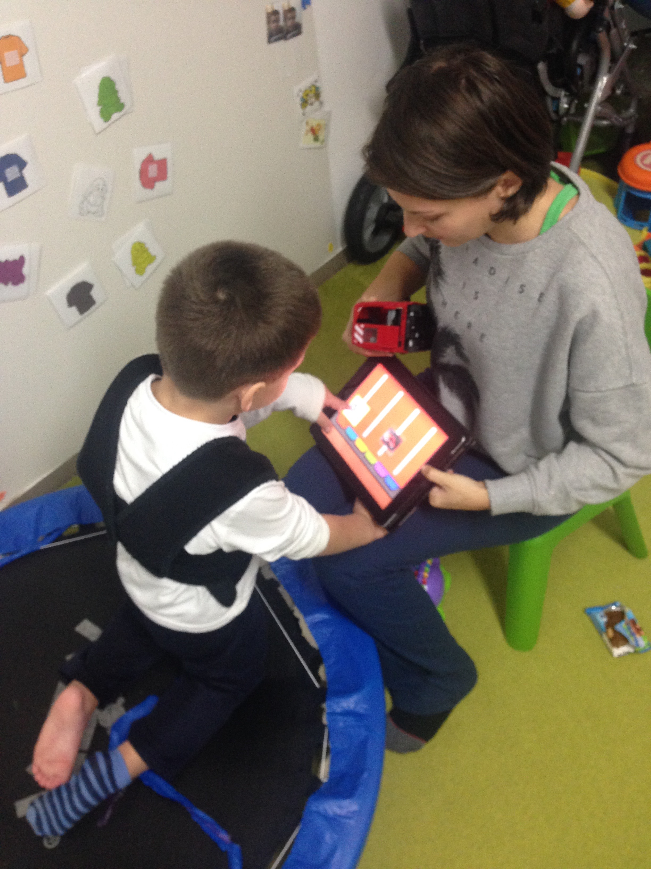
Notes:
Compression vest paired with jumping on trampoline to increase intensity

Slide 89
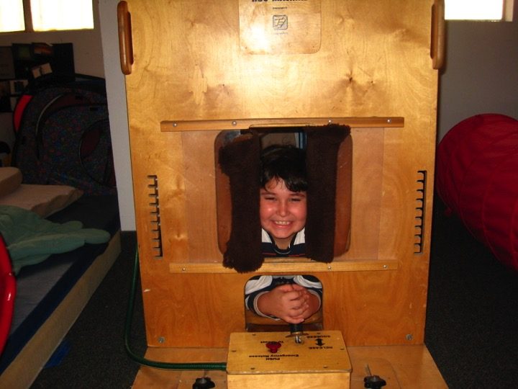

Slide 90
Strategies for Sensory Seeking
Proprioceptive: All environments: Provide joint compressions, engage the child in heavy work activities, School/Clinic: Schedule “brain breaks” throughout the day that require stomping, jumping or running in place while saying words, doing math problems. Complete puzzles, sorting/labeling activities, or story time while prone on elbows (on belly, propped up on elbows) or belly over ball. Provide heavy work activities, such as doing chair push ups, wall push ups, cleaning the chalkboard/whiteboard, moving furniture. Consider using theraband around legs of chair, a weighted vest, or a weighted lap pad (strongly recommend these items be used under the supervision/consultation of an occupational therapist). Home: Assign child chores that require heavy work, such as vacuuming, sweeping, carrying in groceries, do animal walks or wheelbarrow walks from one room to another.

Slide 91
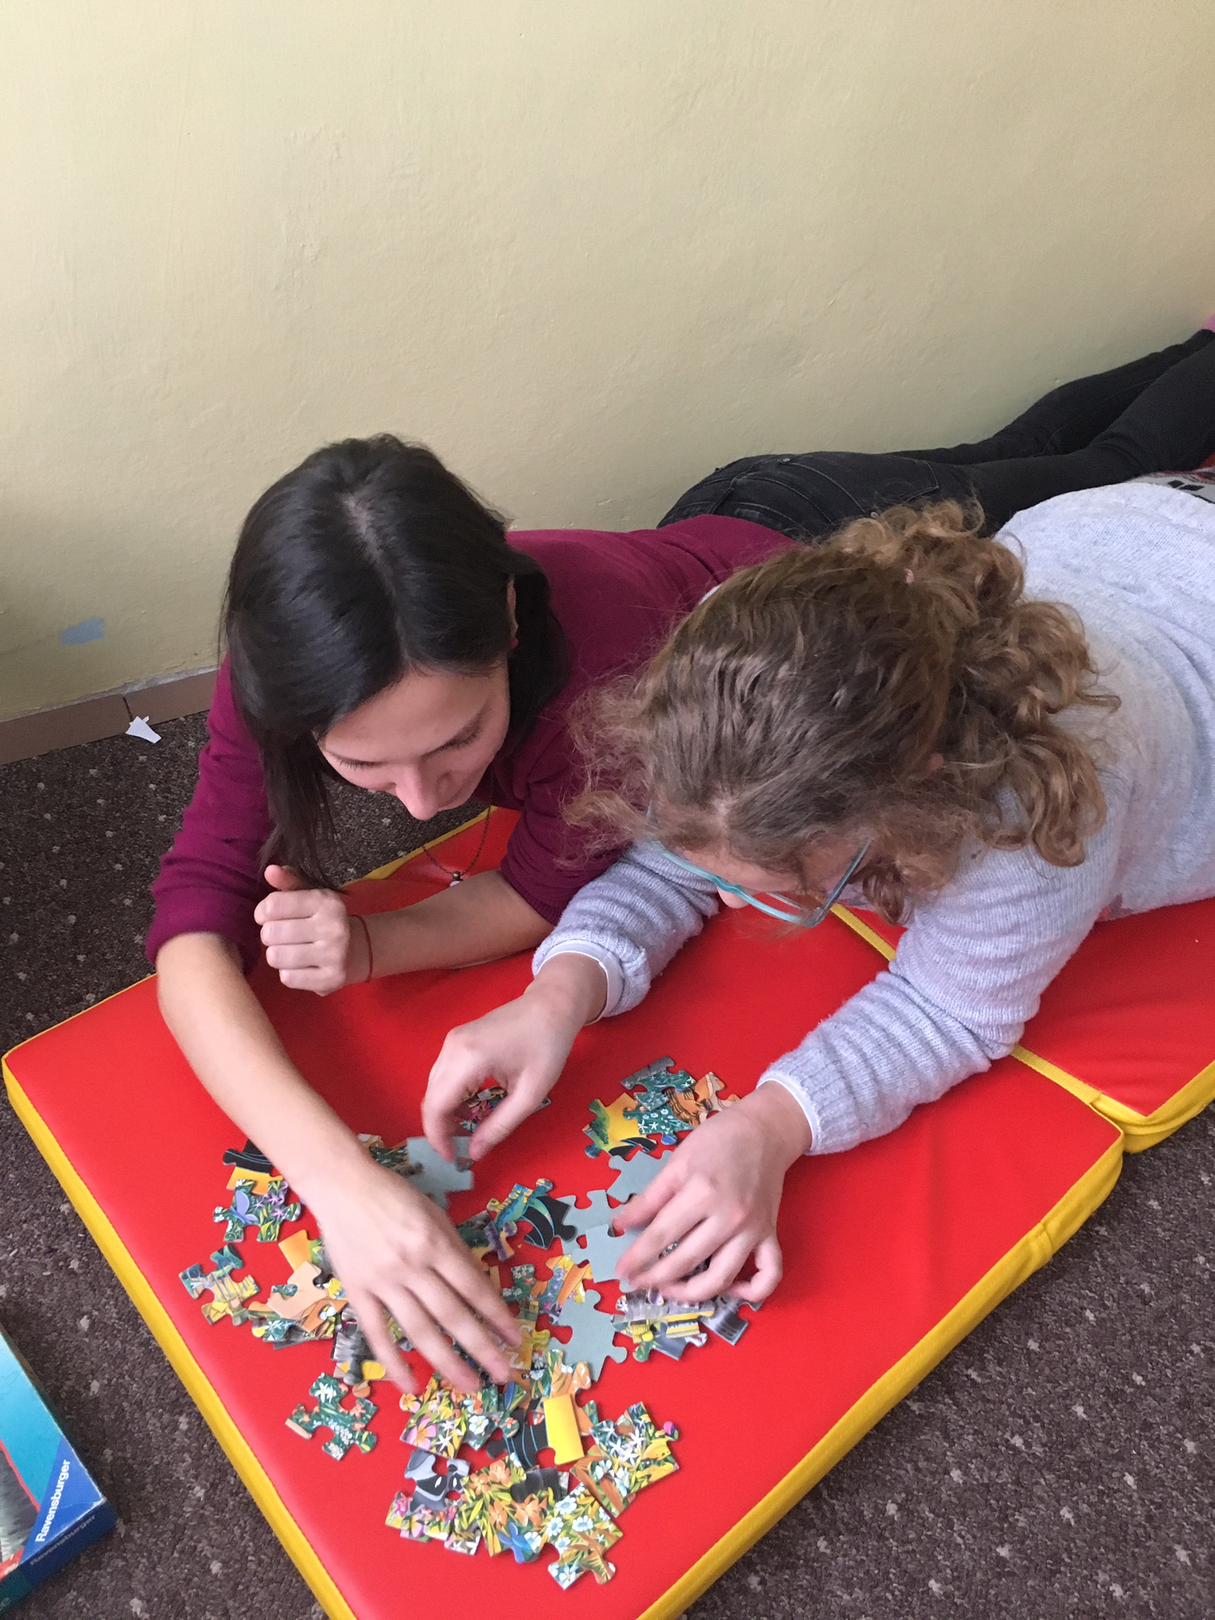
IMG_3232.JPG

Slide 92
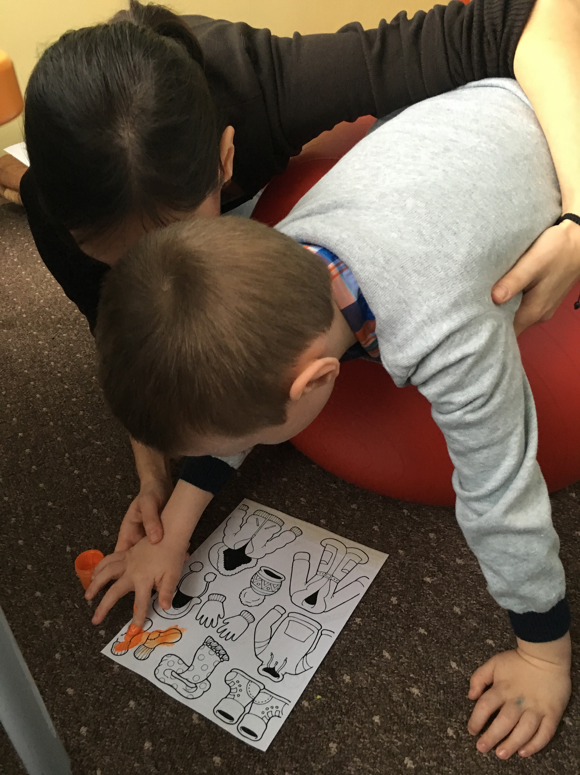

Slide 93
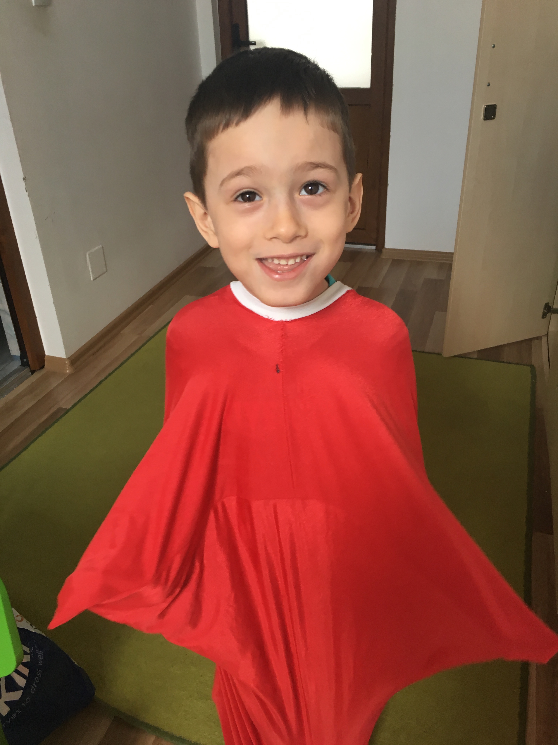

Slide 94
Strategies for Sensory Seeking
Vestibular: School: Provide STRUCTURED/ORGANIZED movement breaks/brain breaks throughout the day. Allow child to sit on ball, tall kneel, use a sensory cushion, or provide a standing work station. Teach limits. Clinic: May need to start with fast, rotary swinging, but then need to gradually transition to slow, linear swinging. When using moving equipment, increase the demands, such as having the child catch/grab/throw items while on swing or when bouncing on ball. Pair proprioceptive input with the vestibular input to help calm. For example, pulling on a rope while swinging, throwing a weighted ball while bouncing. Home: Jumping on a trampoline, paired with throwing/catching a ball, pick up games/activities, swinging at park.

Slide 95
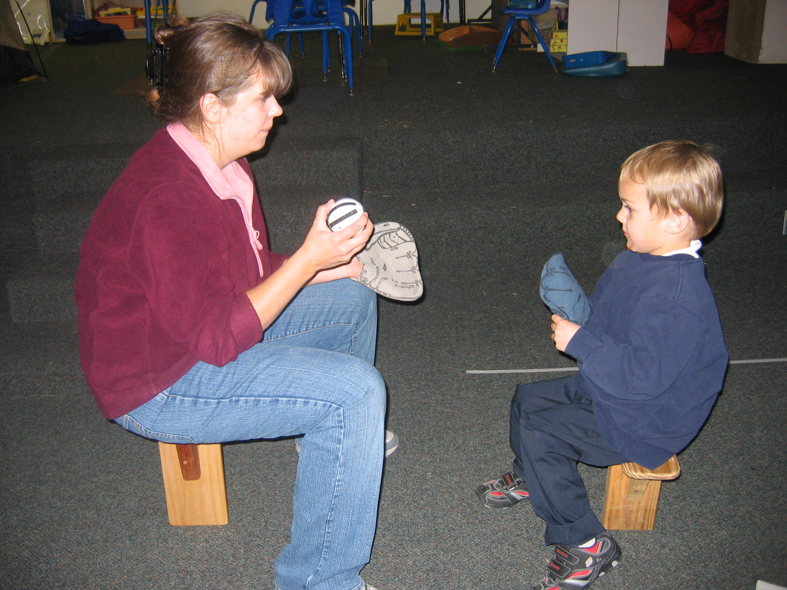

Slide 96
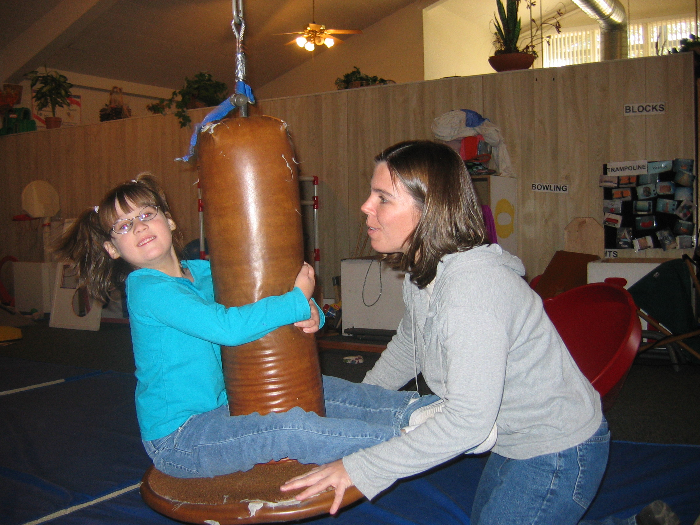

Slide 97
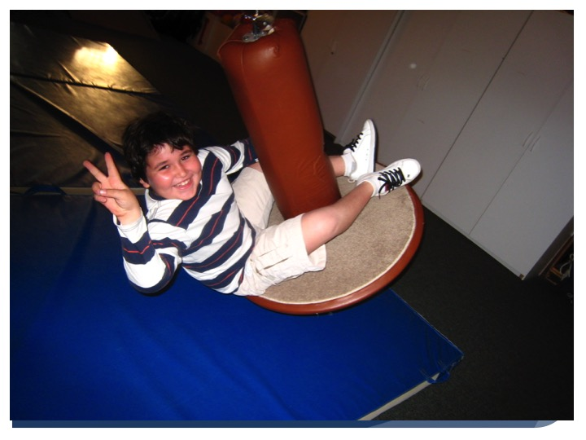

Slide 98
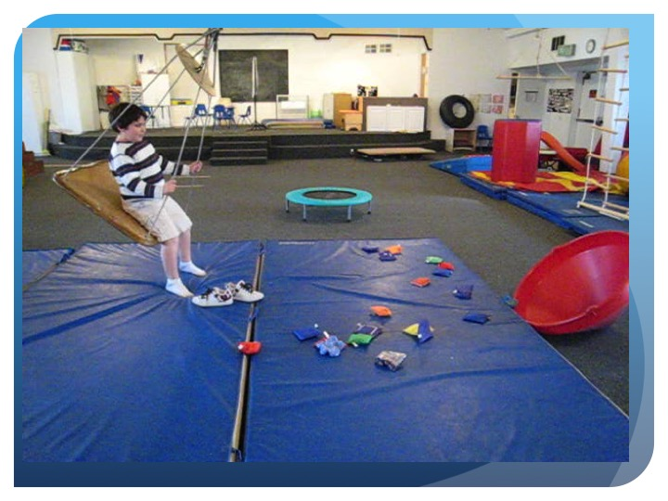

Slide 99
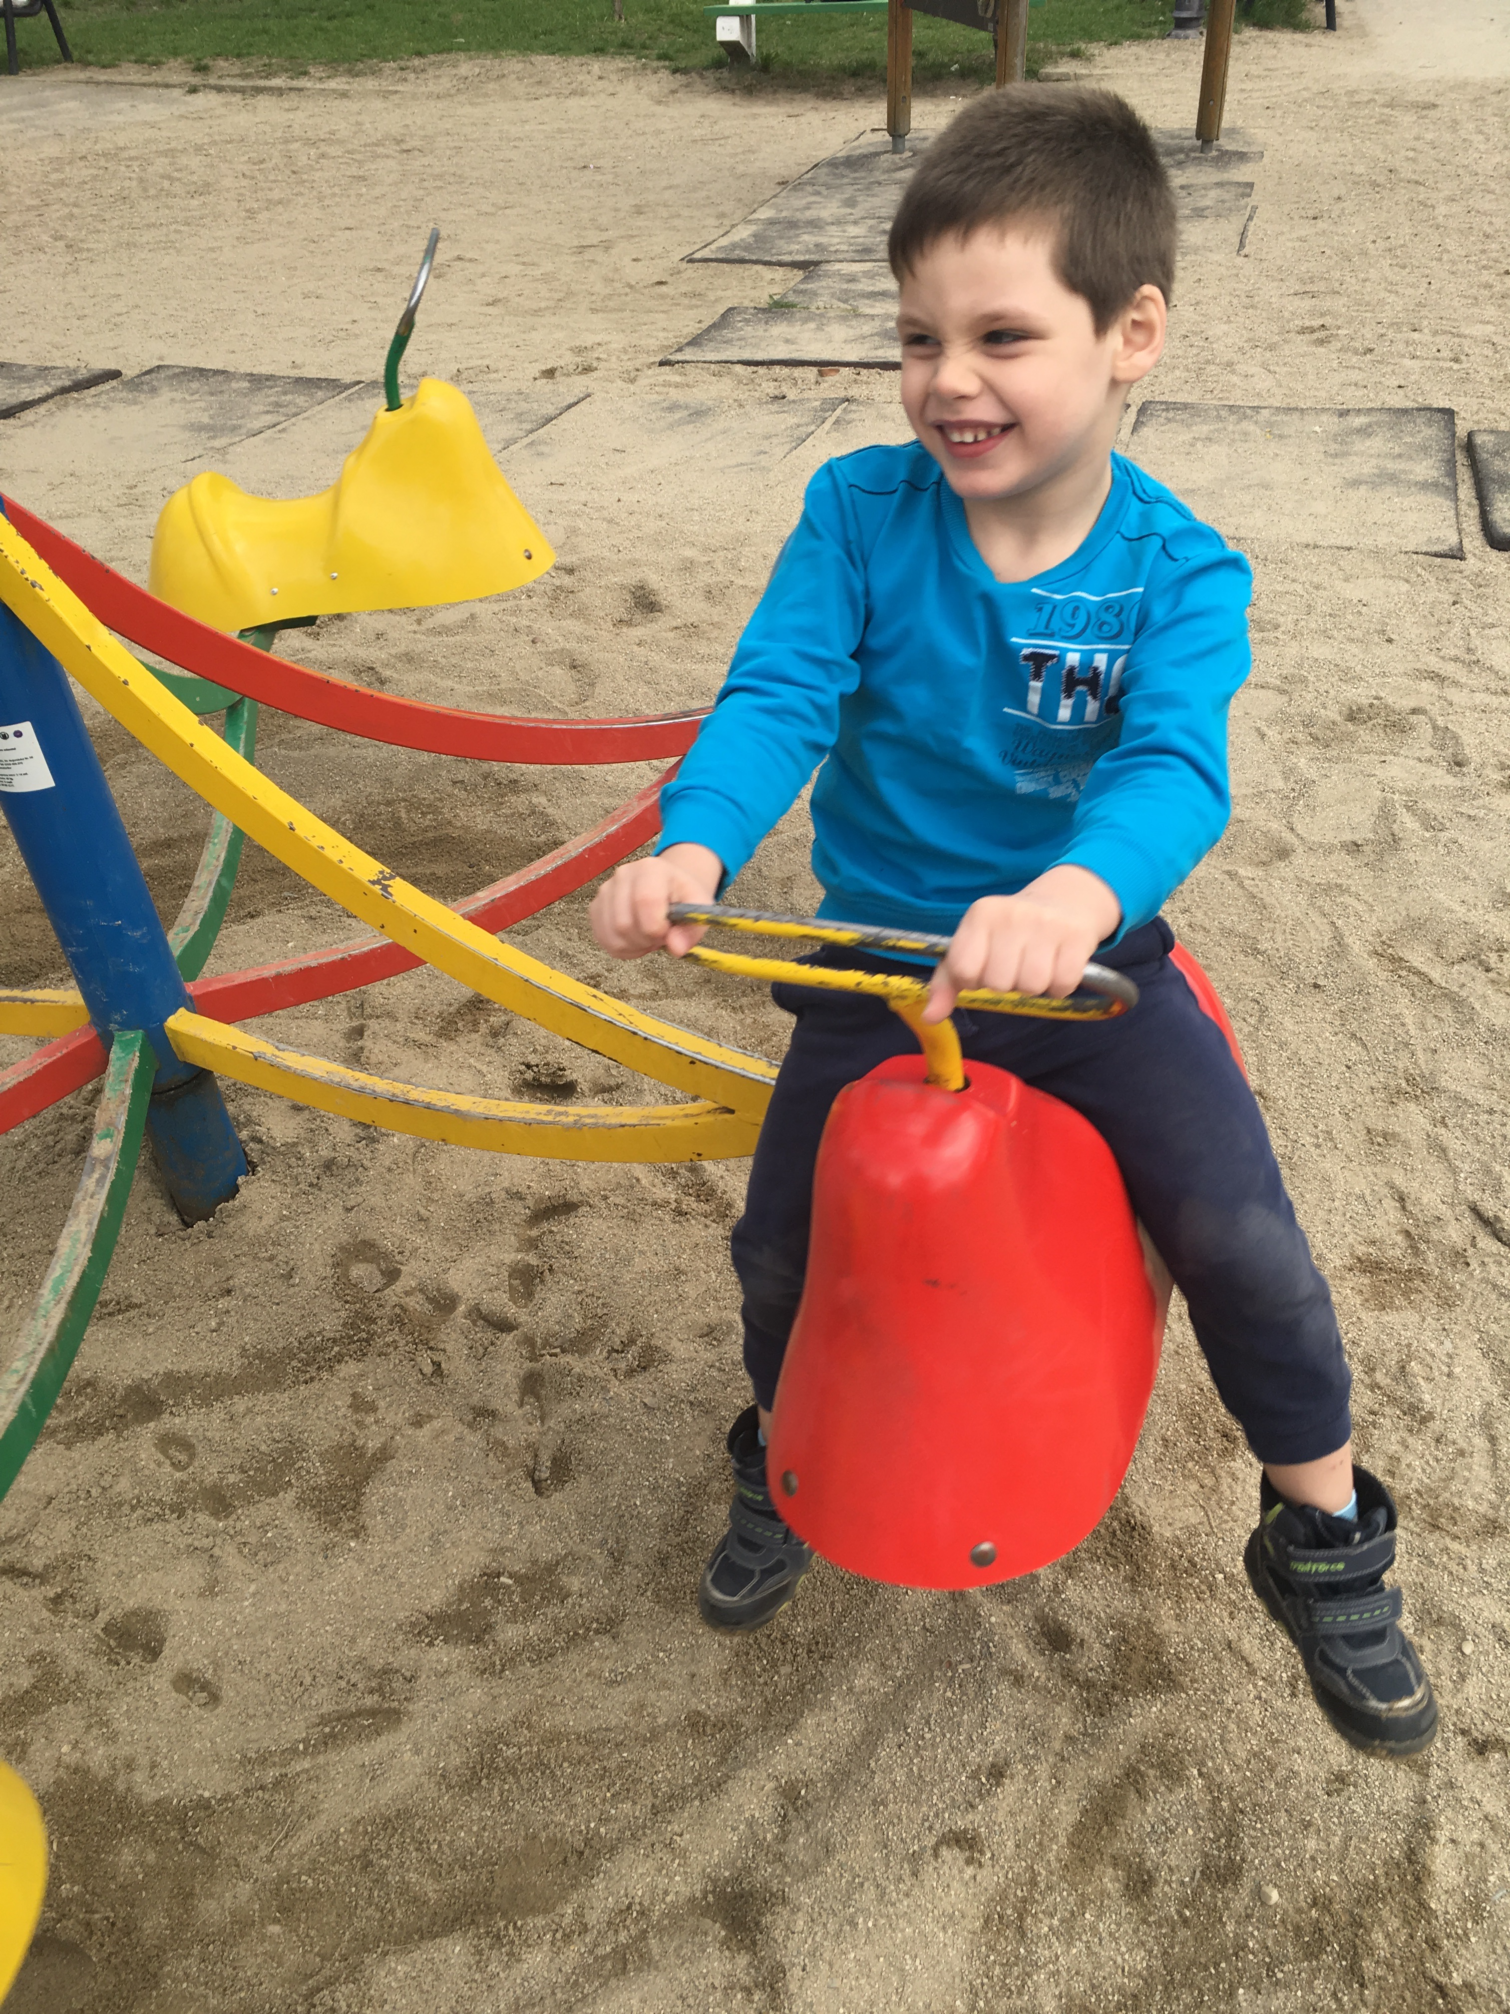

Slide 100
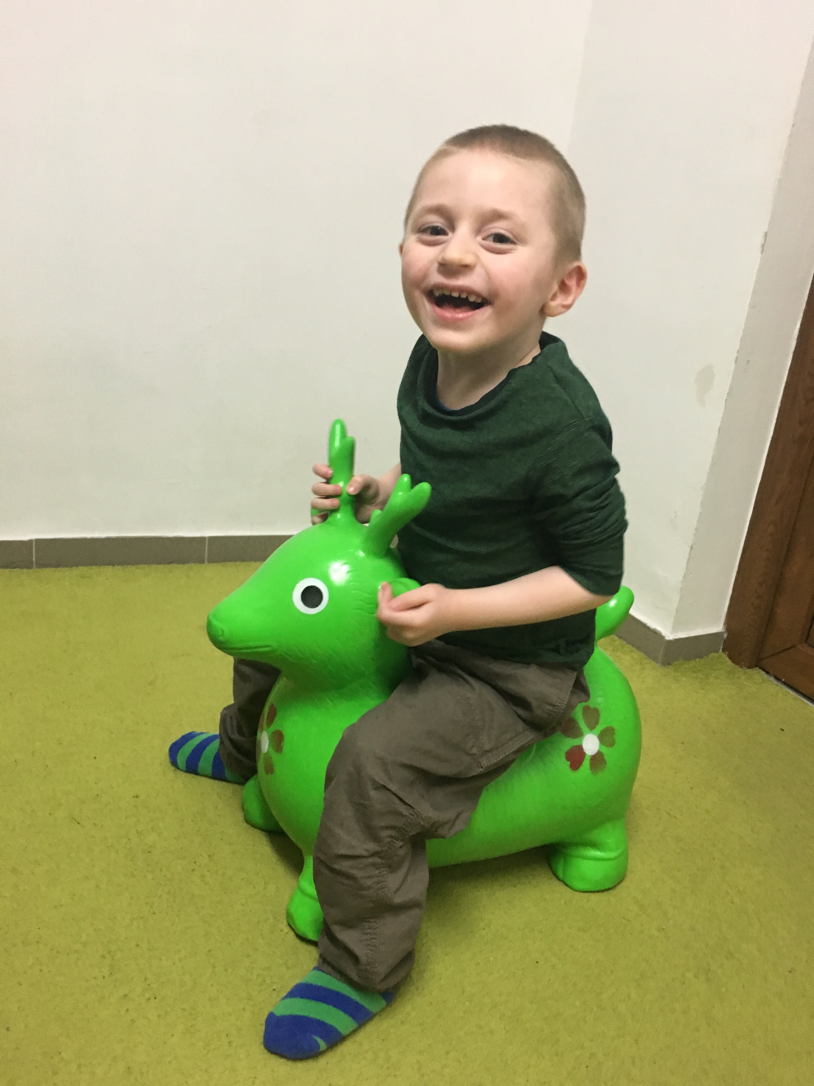

Slide 101
Strategies for Dyspraxia
Engage in activities that involve tactile, proprioceptive and vestibular systems
Break down activities into smaller, more manageable steps to allow for success
Encourage novel play: obstacle courses, activities that require climbing under/over, through, on equipment, jungle gyms, swings, therapy balls, balance boards
Imitation games, such as Simon Says
Encourage games/activities that work on timing, speed and accuracy (kicking a ball, picking up objects while on a swing)

Slide 102
Activities for the Vestibular Sense
Rocking (linear and rhythmic for calming; fast/rotary/stop and start for alerting)
Swinging (slow and rhythmic for calming, fast and with quick stop/starts for alerting)
Bouncing on a ball
Jumping (on a trampoline, on a bed, or while holding on to adult’s hands)
Sitting on floor facing another child or adult, holding hands and rocking back and forth (also good for proprioception as it involves pushing and pulling)
Dancing
Running games with fast stop/start activities
“Pick up” games or “clean up” which requires child to lean forward/bend head
For children in wheelchairs: spin w/c in circles (if child tolerates), do w/c races with stop/go.

Slide 103
Activities for the Proprioceptive Sense
Pushing/pulling games
Playing tug-of-war (rope games)
Climbing structures/playground equipment
Heavy work activities (lifting, carrying, digging, cleaning table/windows, vacuuming, sweeping)
Marching/stomping games
Joint compressions
Chew on crunchy foods
Wall push-ups, chair push-ups
Tummy time on elbows (while watching TV, reading a book)
“Animal walks”
Jumping on bed or trampoline
“Sandwich” games (“making a sarmale”), whole body compression activities (rolling exercise ball over the body)
Crawling/pushing ball through a knit fabric tunnel
Blanket rides
Use weighted vests/blankets

Slide 104
Activities for the Tactile Sense
Lotion rubs (follow by joint compressions -proprioception)
Deep pressure squeezes
Rolling a large therapy ball down the child’s body
Rolling/wrapping child in blanket
Messy play with fingers/hands and feet
Feely Bags (try with eyes closed if child is able)
“Texture of the week” activities (smooth, rough,
Tactile “walk”, walking on various textures and describing
Trace numbers, letters, shapes on child’s hand or back and have him guess what you traced
Bury objects in a container or dried rice or beans and have child reach in to find them (try with eyes closed if child is able)
Drawing/writing in shaving cream, whipped cream. etc
No-mess “messy” play: modifying tactile activities for children with tactile defensiveness

Slide 105
References
Ayres, A.J. (2005). Sensory integration and the child, 25th anniversary edition. Los Angeles, C.A.: Western Psychological Services.
Blanche, E,I. and Pediatric Therapy Network. (2002). Observations Based on Sensory Integration Theory.
Boundless. “Audition: Hearing, the Ear, and Sound Localization.” Boundless Psychology. Boundless, 20 Aug. 2015. Retrieved 23 Mar. 2016 from https://www.boundless.com/psychology/textbooks/boundless-psychology-textbook/sensation-and-perception-5/sensory-processes-38/audition-hearing-the-ear-and-sound-localization-162-12697/
Bundy, A.C., Lane, S., & Murray, E.A., (Eds). (2002) Sensory Integration: Theory and Practice (2nd ed). Philadelphia: F.A. Davis
Kranowitz, C.S. (2003). The out-of-sync child has fun: Activities for children with sensory integration dysfunction. New York: Perigree
Miller, L.J. (2014). Sensational kids. New York: Perigree
Roley, S.S, Blanche, E.I, & Schaaf R.C. (Eds). (2001). Understanding the nature of sensory integration with diverse populations. Austin, TX: pro-ed

